Slide 1
The North Chapter 12

Slide 2
Industrial Revolution in America
Chapter 12
Section 1
P384-389

Slide 3
New Machines lead to the Industrial Revolution
Most people at the beginning of the 1700s were farmers, who made most of what they needed by hand.
Skilled workers, such as blacksmiths, carpenters, and shoemakers, made goods by hand in the towns.
People began using machines to make the manufacturing process more efficient.
The Industrial Revolution, a period of rapid growth using machines to make goods, arose in Great Britain in the mid-1700s.

Slide 4
Textile Industry
The first breakthrough in the Industrial Revolution was in how textiles, or cloth goods, were made.
Richard Arkwright, an Englishman, invented a spinning machine in 1769 called the water frame, which replaced hand spinning.
The water frame used flowing water as a source of power.
Could produce dozens of cotton threads at the same time
Lowered the cost of cotton production and increased the speed of textile production

Slide 5
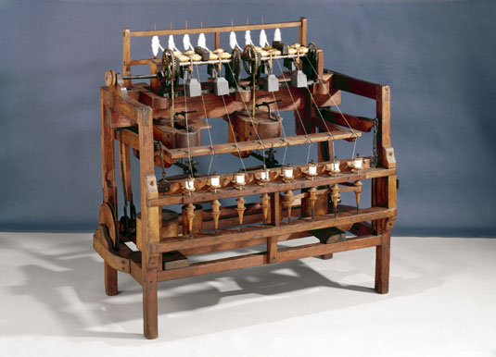

Slide 6
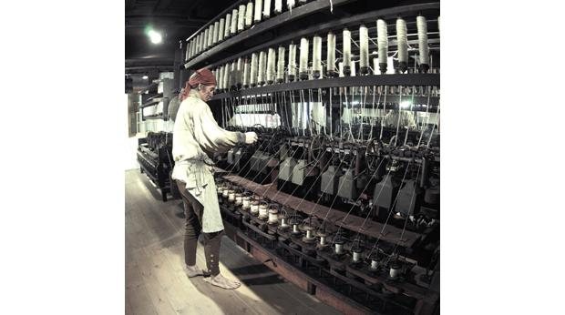

Slide 7
Merchants built textile mills near rivers and streams.
Great Britain soon built the world’s most productive textile manufacturing industry.
Samuel Slater brought the secrets of textile mill manufacturing from Great Britain to the United States.
The textile industry arose in the Northeast, introducing the Industrial Revolution to the United States.

Slide 8
Manufacturing Breakthroughs
U.S. factories needed better technology, or tools, to manufacture muskets.
Inventor Eli Whitney developed musket factories using water-powered machinery.
Whitney introduced the idea of interchangeable parts, or parts of a machine that are identical, to make musket manufacturing easier.
Interchangeable parts sped up the process of mass production.

Slide 9
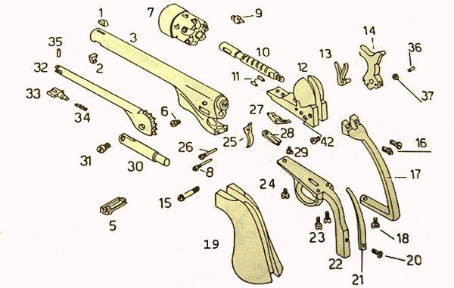

Slide 10
Improvements during War of 1812
Lower British prices on manufactured goods made it difficult for American manufacturing to grow.
American manufacturing was limited to cotton goods, flour milling, weapons, and iron products.
The War of 1812 cut off trade with Great Britain, allowing manufacturing in the United States to prosper and expand.
Americans realized that the United States had been relying too heavily on foreign goods.

Slide 11
Changes in Working Life
Chapter 12
Section 2
P390-395

Slide 12
Mills Change Workers’ Lives
Factory jobs usually involved simple, repetitive tasks done for low pay.
Could not find workers because of the simple work and the fact that other jobs were available
The mill industry filled jobs by hiring whole families, and paying children low wages.
Built housing for workers and provided a company store
Samuel Slater’s strategy of hiring families and dividing factory work into simple tasks was called the Rhode Island system.

Slide 13
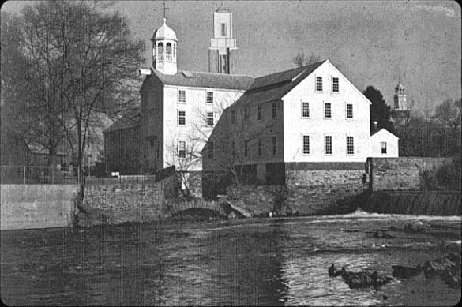

Slide 14
Lowell System
Francis Cabot Lowell created a new system of mill manufacturing in 1814, called the Lowell system.
The Lowell system involved
Employing young, unmarried women, who were housed in boardinghouses
Providing clean factories and free-time activities for its employees
Having mills that included both spinning thread and weaving in the same plant

Slide 15
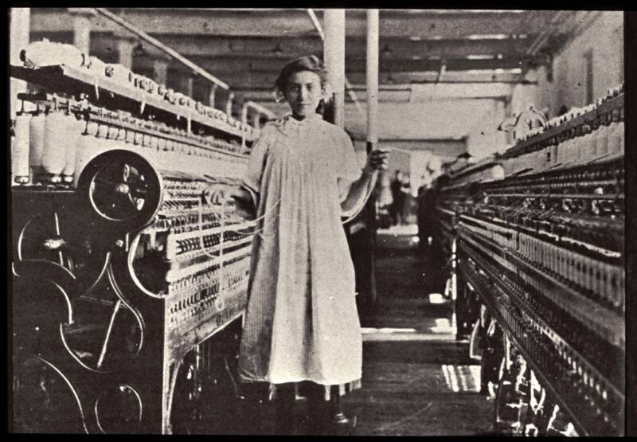

Slide 16
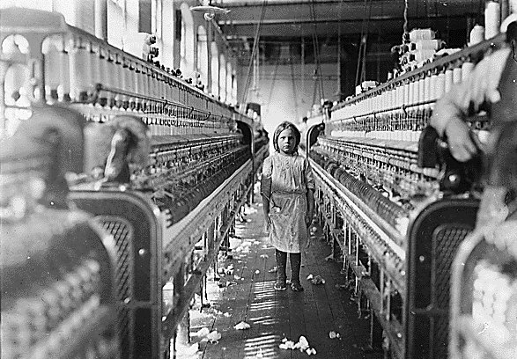

Slide 17
Workers Organize to Reform Working Conditions
Deteriorating Working Conditions
Employees worked 12-to-14 hour days in unhealthy conditions.
Craftsmen’s wages dropped in competition against cheap manufactured goods.
Wages of factory workers dropped as they competed for jobs.
Trade Unions Formed
Craftsmen formed trade unions to gain higher wages and better working conditions.
Factory workers also formed trade unions.
Labor unions staged protests called strikes, refusing to work until employers met their demands.

Slide 18
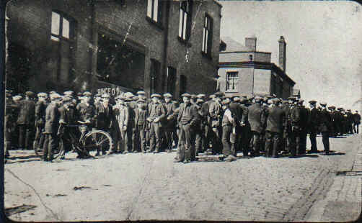

Slide 19
Labor Reform Efforts
Millworker Sarah G. Bagley helped lead the union movement in Massachusetts.
Bagley’s union campaigned to reduce the 12-to 14-hour workday to a 10-hour workday.
Union workers won some victories, as several states passed 10-hour workday laws.
In other states the workday remained long and child labor prevailed.

Slide 20
The Transportation Revolution
Chapter 12
Section 3
P396-401

Slide 21
The Transportation Revolution Affects Trade and Daily Life
The 1800s gave rise to Transportation Revolution: period of rapid growth in new means of transportation
Transportation Revolution created boom in business by reducing shipping costs and time
Two new forms of transportation were steamboat and steam-powered trains
Goods, people, and information were able to travel rapidly and efficiently across the United States.

Slide 22
The Steamboat
Robert Fulton invented the steamboat, testing the Clermont in 1807.
Steamboats increased trade by moving goods more quickly and more cheaply.
More than 500 steamboats were in use by 1840.
Gibbons v. Ogden (1824): The Supreme Court reinforced the federal government’s authority to regulate trade between states.
Gibbons argued that a federal license meant he could use New York waterways without another license.
The Supreme Court agreed with Gibbons.

Slide 23
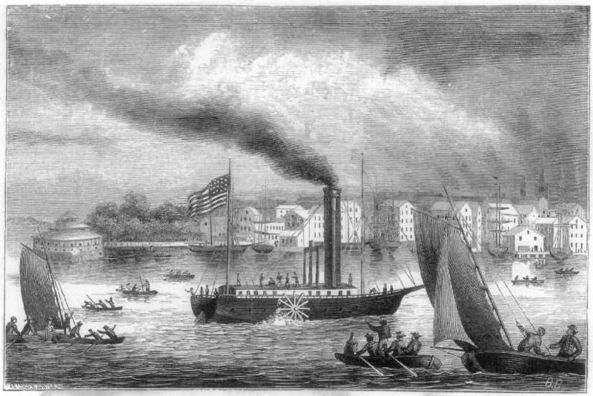

Slide 24
Railroads
Steam-powered trains had been developed in Great Britain, but it took 30 years for the idea to catch on in the United States.
Peter Cooper raced his Tom Thumb locomotive against a horse in 1830, proving its power and speed despite losing because of a breakdown near the end of the race.
About 30,000 miles of railroads linked American cities by 1860.
The U.S. economy surged as railroads moved goods cheaply to distant markets.

Slide 25
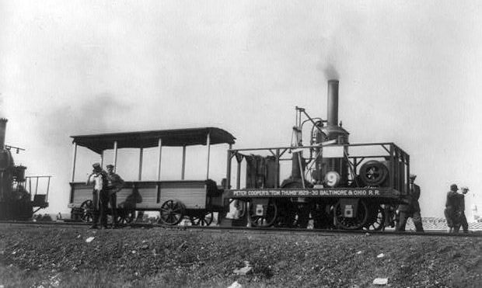

Slide 26
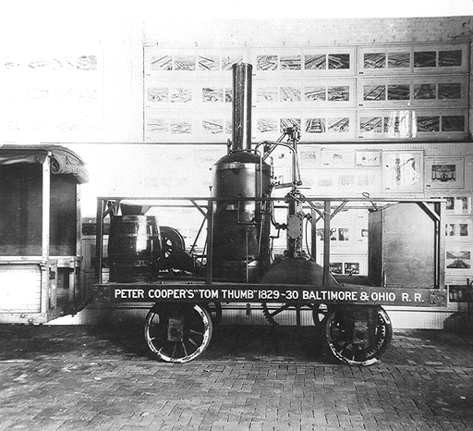

Slide 27
Transportation Revolution Brings Changes to Life and Industry
People in all areas of the nation had access to products made and grown far away.
Railroads contributed to the expansion of the nation’s borders.
Cities and towns grew up along railroad tracks.

Slide 28
Impact of Railroads
Coal replaced wood as a source of fuel as trains grew bigger.
Railroads helped create the coal industry.
Coal, shipped cheaply on trains, became the main fuel in homes and in the emerging steel industry.
Railroads helped the lumber industry grow, leading to large-scale deforestation.
Railroads caused cities to grow, including Chicago, which became a transportation hub.

Slide 29
More Technological Advances
Chapter 12
Section 4
P402-405

Slide 30
The Telegraph
In 1832, Samuel F. B. Morse perfected the telegraph—a device that could send information over wires.
The device did not catch on until the 1844 Democratic National Convention, when the nomination was telegraphed to Washington.
A Morse associate created Morse code to communicate messages over the wires.
Morse code turned pulses of electric current into long and short clicks.
Clicks, also called dots and dashes, were arranged in patterns representing letters of the alphabet.
The telegraph grew with the railroad; the first transcontinental railroad line was completed in 1861.

Slide 31
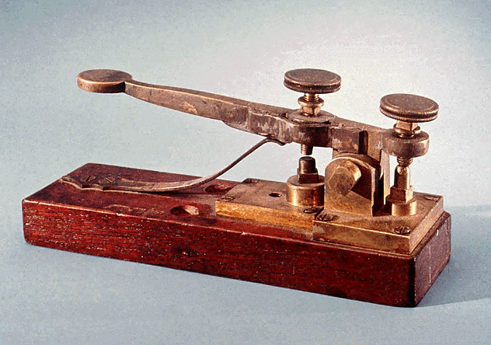

Slide 32
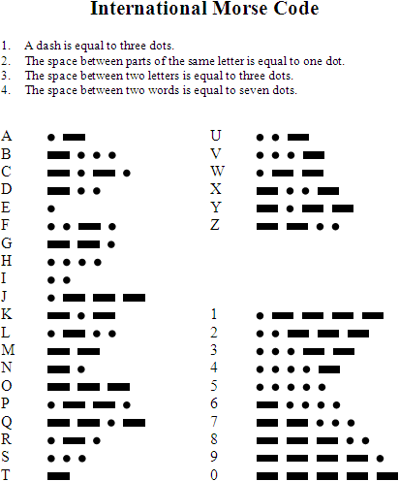

Slide 33
Shift to Steam Power
The shift from water power to steam power allowed owners to build factories anywhere.
Factories were shifted closer to cities and transportation centers.
Cities became centers of industrial growth.

Slide 34
Other Devices Make Life Easier
John Deere designed a steel plow in 1837 that replaced the less efficient iron plow.
Cyrus McCormick developed a mechanical reaper in 1831, which quickly and efficiently harvested wheat.
McCormick used a new method to encourage sales, advertising.
He also allowed people to buy on credit and provided repairs and spare parts for his machines.
These inventions allowed farmers to plant and harvest huge crop fields, helping the country prosper.

Slide 35
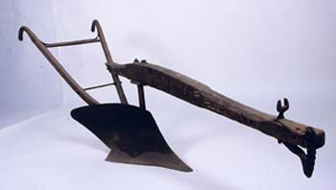

Slide 36
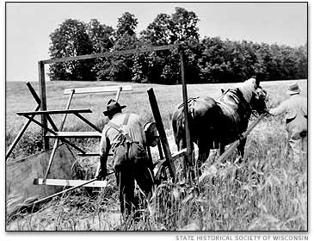

Slide 37
New Inventions in American Homes
The sewing machine, invented by Elias Howe and improved by Isaac Singer, made home sewing easier.
Ice boxes and iron cookstoves improved household storage and preparation of food.
Mass-produced goods, such as clocks, matches, and safety pins, added convenience to households.

Slide 38
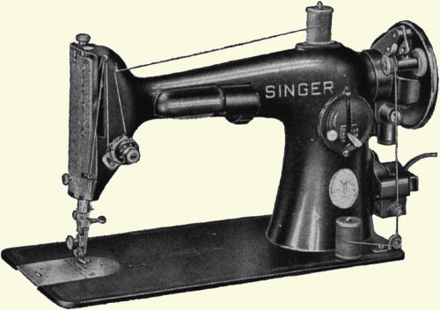

Slide 39
