Slide 1
THE SOUTH

Slide 2
Growth of the Cotton Industry
Chapter 13
Section 1
P414-419

Slide 3
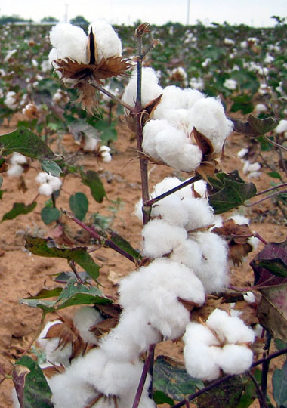
The invention of the cotton gin revived the economy of the South
Prices for major southern crops—tobacco, rice, and indigo— fell after the American Revolution.
Cotton was not profitable, because of the difficulty of removing seeds.
Demand for American cotton grew rapidly with the rise of British textile mills.

Slide 4
Cotton is King
Eli Whitney patented the cotton gin, a machine to remove seeds from cotton, in 1793.
Planters—large-scale farmers—soon adopted the cotton gin and were able to process tons of cotton much faster than hand processing.
A healthy cotton crop could now guarantee financial success because of high demand.

Slide 5
The cotton gin created a cotton boom in which farmers grew little else
Cotton gin made cotton so profitable that southern farmers abandoned other crops.
Removal of Native Americans opened up more land for cotton farmers in Southeast.

Slide 6
Development of new types of cotton helped spread production throughout South, as far west as Texas.
This area became known as the cotton belt.
United States produced more than half the cotton grown in the world by 1840.
Economic boom attracted new settlers, built up wealth among white southerners, and firmly established slavery in the South.

Slide 7
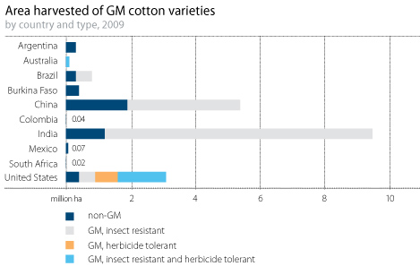

Slide 8
Cotton Belt
Cotton had many advantages as cash crop: inexpensive to market and easy to store and transport.
Cotton had major disadvantage—used up nutrients in soil—so farmers began crop rotation.
Farmers developed stronger types of cotton through crossbreeding, which expanded the cotton industry.
Cotton industry was labor intensive; need for more slaves caused increase in internal slave trade. Instead of paying free workers, planters used enslaved Africans.

Slide 9
Cotton Trade
Southern cotton was used to make cloth in England and the North.
Great Britain became the South’s most valued foreign trading partner.
Increased trade led to the growth of port cities, including Charleston, Savannah, and New Orleans.
Crop brokers, called factors, managed the cotton trade.

Slide 10
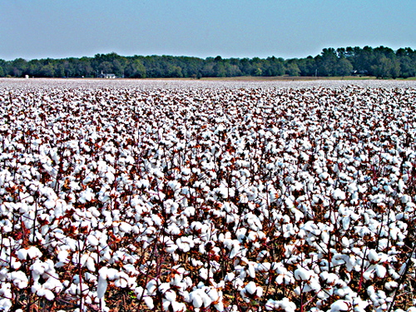

Slide 11
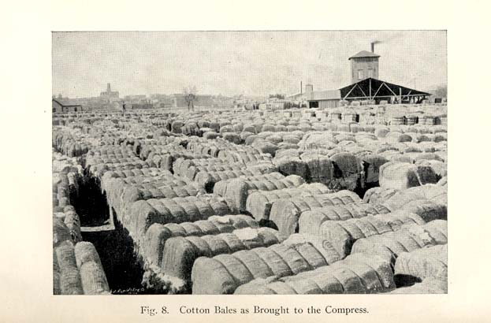

Slide 12
Some people encouraged southerners to focus on other crops and industries
Agriculture
Corn—primary food crop.
Other food crops—rice, sweet potatoes, wheat, and sugarcane.
Tobacco production- curing and drying leaves very time consuming
Production increased when a slave developed an improved drying process.
Hemp and flax also became cash crops.
As long as agriculture profits remained high, investors preferred to invest in land.

Slide 13
Industry
Factories in South built to serve farmers’ needs.
Nation’s first steam-powered sawmill built in Louisiana in 1803.
Entrepreneurs began investing in cotton mills by 1840s.
Tredegar Iron Works: one of nation’s most productive iron works.
Owner- Joseph R. Anderson
Industry remained a small part of southern economy.

Slide 16
End of Section

Slide 17
Southern Society
Chapter 13
Section 2
P420-423

Slide 18
Southern society and culture consisted of four main groups
Only a third of white southern families had slaves; fewer families had plantations.
Planters had a powerful influence over the South.
Other social groups included yeoman farmers, poor whites, slaves, and free African Americans.

Slide 19
White Social Groups in the South
Planters
Wealthiest members of society
Males concerned with crops and slave laborers
Planters’ wives raised children, ran households, and saw to social duties.
Marriages were often arranged.
Yeomen
Yeomen were owners of small farms averaging 100 acres.
Comprised of mostly white southerners
Families worked long hours.
Some yeomen owned slaves.
Poor Whites
Often lived on land that could not grow crops
Survived by hunting, fishing, raising small gardens, and doing odd jobs

Slide 20
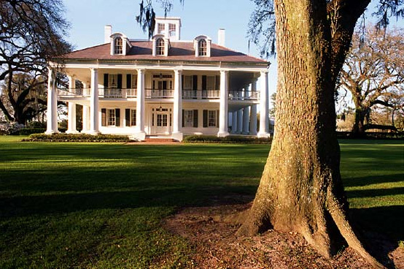
A Southern Plantation
Plantation House
Planter and his family lived here

Slide 21
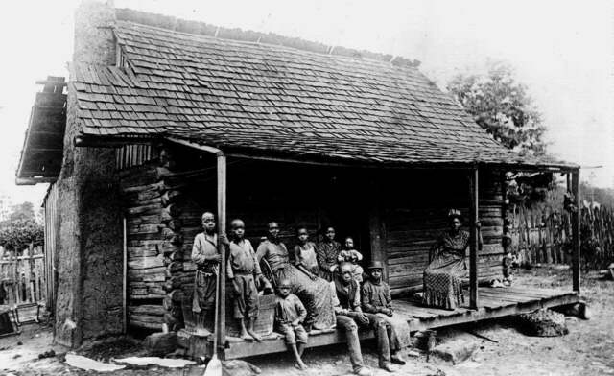
Slave Cabins
Slaves lived, crowded into small cabins

Slide 22
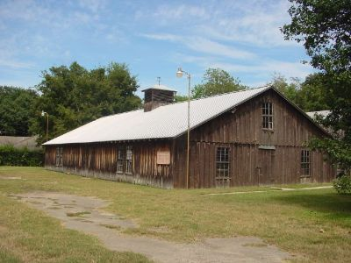
Cotton-Ginning Shed
Vital machines housed in shed to protect them from the weather

Slide 23
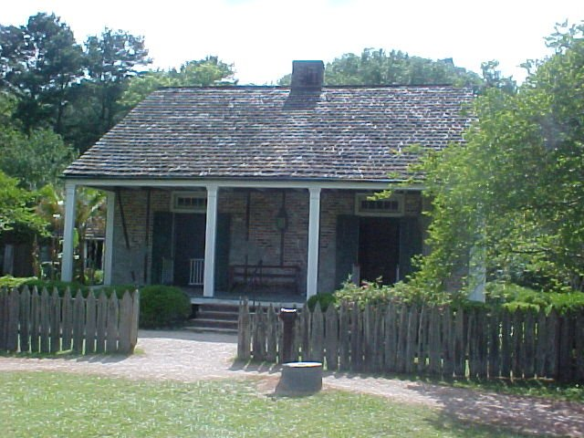
Other Buildings
Overseer’s house, barn, smokehouse, stable

Slide 24
Other Aspects of Southern Society
Religion
Most white southerners shared similar religious beliefs.
Families often saw neighbors only at church events.
Wealthy white southerners thought that religion justified their place in society and the institution of slavery.

Slide 25
Urban Life
Many southern cities were on the Atlantic Coast and began as shipping centers.
City governments built water systems and maintained streets. Some provided public education.
Slaves did much of the work in southern cities.

Slide 26
Free African Americans in the South faced a great deal of discrimination
More than 250,000 free African Americans lived in the South in 1860, in both urban and rural areas.
Most worked as paid laborers on farms; those in cities worked a variety of jobs.
Many governments passed laws limiting the rights of free African Americans—they could not vote, travel freely, or hold certain jobs. Some required that African Americans have a white person represent them in business transactions.
Many white southerners argued that free African Americans did not have the ability to take care of themselves.

Slide 27
The Slave System
Chapter 13
Section 3
P424-429

Slide 28
Slaves worked at a variety of jobs on plantations
Most enslaved African Americans lived in rural areas and worked on farms and plantations.
Most worked in the fields, where plantation owners used the gang-labor system.
All field hands worked on the same task at the same time.
Men, women, and children older than 10 were forced to do the same work from sunup to sundown with little concern for sickness and poor weather.

Slide 29
Other Types of Work Done by Slaves
Some slaves worked as butlers, cooks, or nurses in planter’s house.
They often had better food, clothing, and shelter than field hands but usually had to work longer hours.
Some worked skilled jobs, such as blacksmithing or carpentry.
Some slaveholders let their slaves sell their labor to other people.
Some slaves earned enough money this way to buy their freedom.

Slide 30
Life under slavery was difficult and dehumanizing
Slaveholders viewed slaves as property, not people. Slaves could be sold at auction, with families often separated with little hope of reunion.
Slave traders sometimes kidnapped free African Americans and sold them into slavery.
Enslaved people often endured poor living conditions, such as dirt-floor cabins, cheap, coarse clothing, and small food rations.
Some planters used punishment to encourage slaves’ obedience. They used irons and chains, stocks, and whips to punish slaves and also passed strict slave codes to prohibit movement.

Slide 31
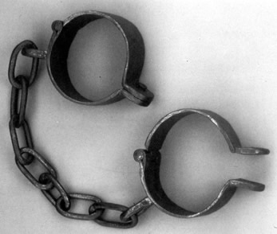
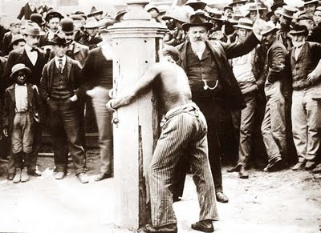

Slide 33
Slave culture centered around family, community, and religion
Family was the most important aspect of slave communities.
Slave parents passed down family histories and African cultures and traditions.
Slaves told folktales to teach lessons about how to survive under slavery.

Slide 34
Religion played an important part in slave culture.
By the early 1800s many slaves were Christians.
They believed they were like the Hebrew slaves in ancient Egypt and would someday have freedom.
Some slaves sang spirituals to express religious beliefs.
Slaves attempted to rebel in many ways, including holding their own religious beliefs, slowing down work, and planning escapes.

Slide 35
Slave uprisings led to stricter slave codes in many states
White southerners lived in fear of slave revolts, which were relatively rare.
Nat Turner’s Rebellion was the most violent slave revolt.
In 1831 Nat Turner, a slave, led a group of slaves in a plan to kill all slaveholders in the county, killing about 60 white people.
More than 100 innocent slaves were killed in an attempt to stop the rebellion.
Turner was captured and executed.
Many states strengthened slave codes, placing stricter controls on the slave population as a result.

