Slide 1
New Movements in America
Chapter 14
Section 1 p438-442
Immigrants and Urban Challenges
Section 2 p443-447
American Arts
Section 3 p448-453
Reforming Society
Section 4 p454-460
The Movement to End Slavery
Section 5 p461-67
Women’s Rights

Slide 2
Immigrants & Urban Challenges
Section 2: p438-442
KEY TERMS:
Nativists: Americans and other who opposed immigrants
Know-Nothing Party:
political organization who worked to bar immigrants from citizenship and political office
Middle Class: a new economic class between the wealthy and the poor
Tenements: poorly designed apartment buildings that were overcrowded

Slide 3
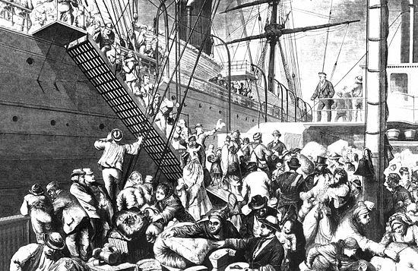
Millions of Immigrants arrive
More than 4 million immigrants settled in the US between 1840 & 1860
Most arrived from European countries
Over 3 million were from Ireland and Germany
German Émigré’ leaving Hamburg for the US

Slide 4
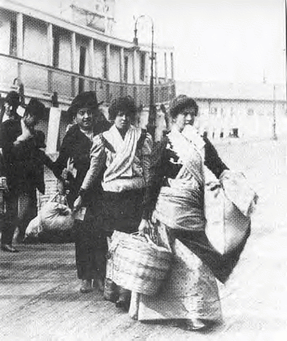
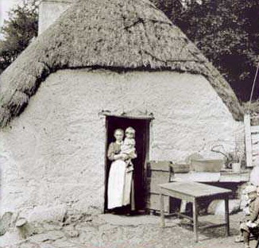
The Irish Potato Famine of the 1840’s led many Irish to Immigrate to the US in search of a better life

Slide 5
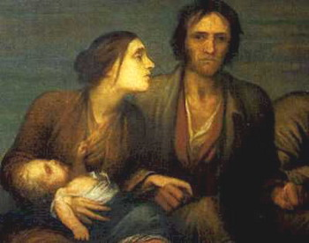

Slide 6
The Irish Potato Famine of 1840’s
killed over 1 million Irish and caused millions more to leave Ireland
Most Irish were very poor

Slide 7
They settled mainly in the Northeast: Massachusetts, New Jersey, New York, & Pennsylvania

Slide 8
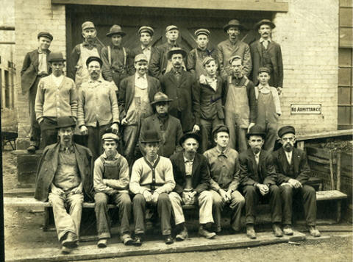
Men worked as unskilled laborers in factories or building canals and railroads. Women often worked as domestics.

Slide 9
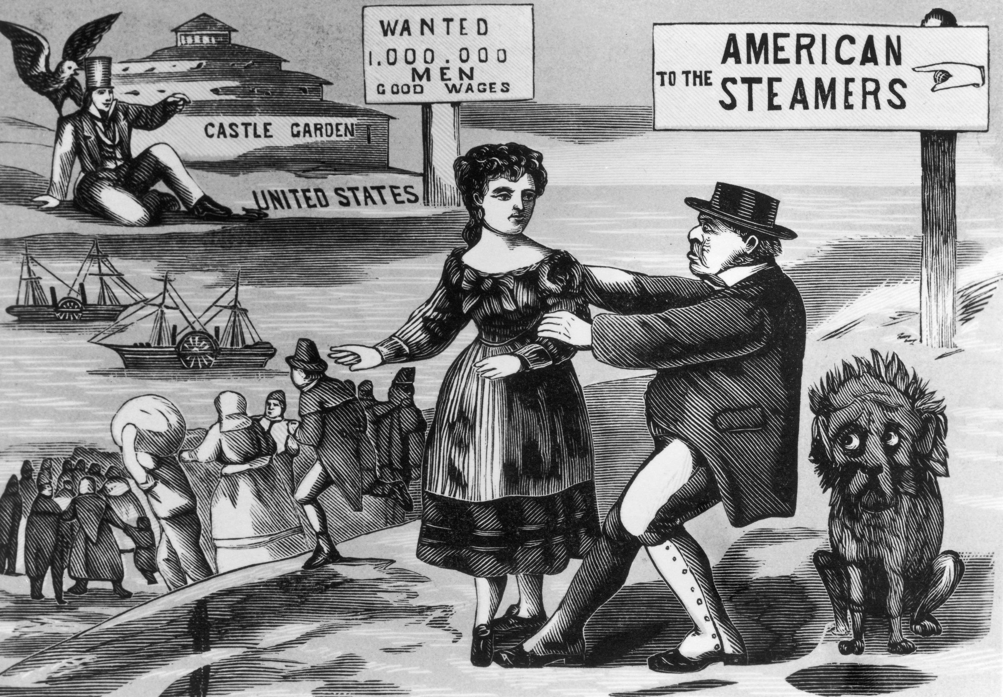
Despite harsh conditions, low wages and poor housing many saw America as a land of equality and opportunity

Slide 10
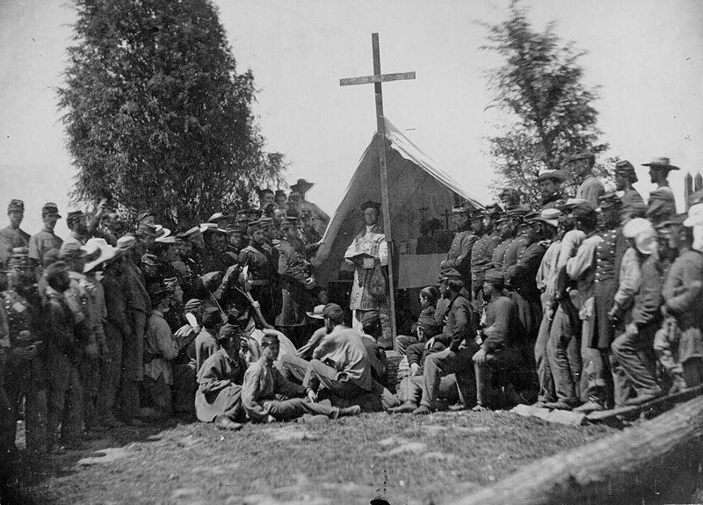
Most Irish immigrants were Catholic

Slide 11
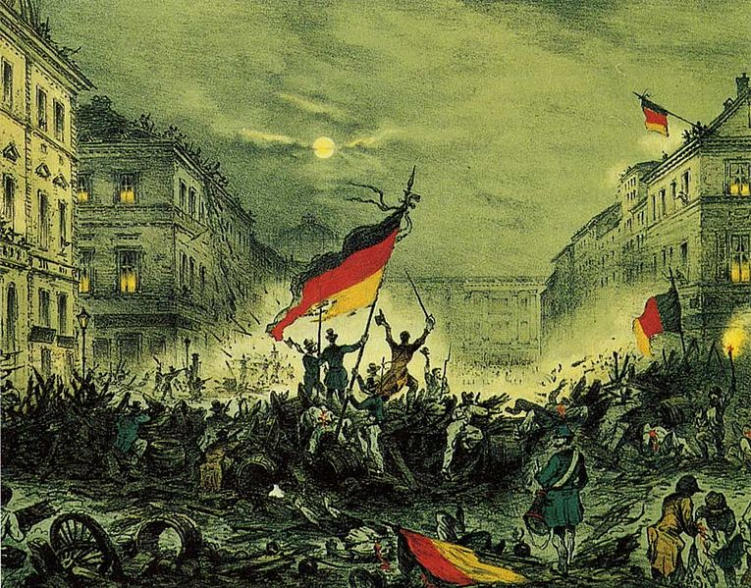
In 1848 a failed revolution in Germany caused many of Germany’s educated upper class to flee political persecution

Slide 12
A Failed German Revolution
However, most German immigrants were working class and came to America for economic reasons
While most Irish were Catholic, Germans were a mix of Catholics, Jews and Protestants
German immigrants were more likely than Irish to become Farmers in the new land

Slide 13
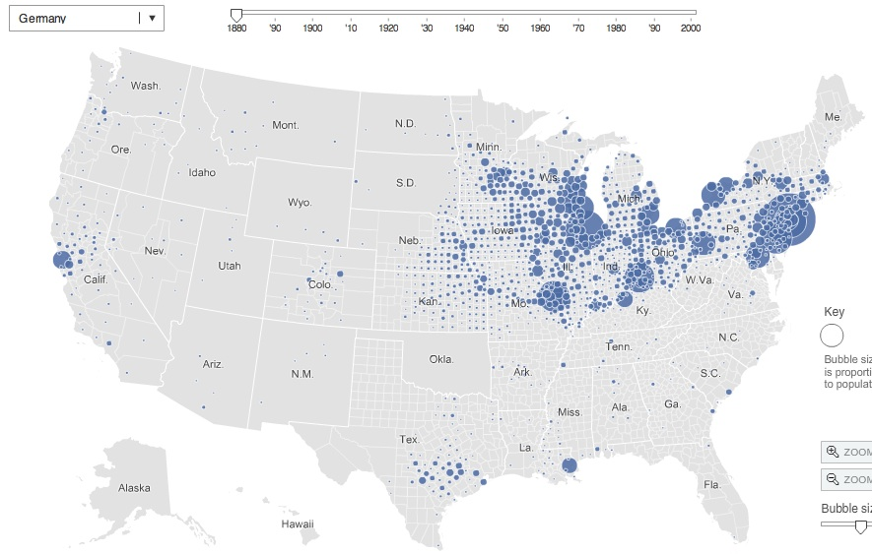
Population Density of German Born Americans in 1880

Slide 14
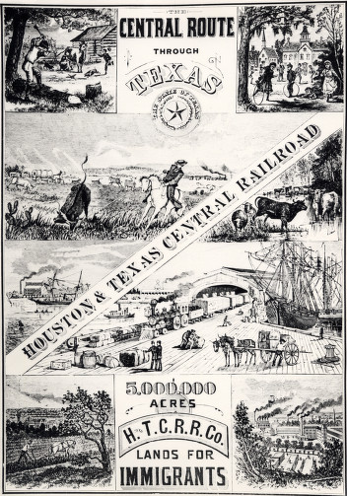
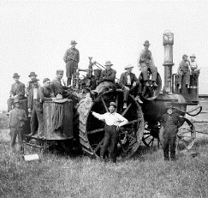
They moved to the Midwest where there was more land available
They usually had more money to fund their immigration

Slide 15
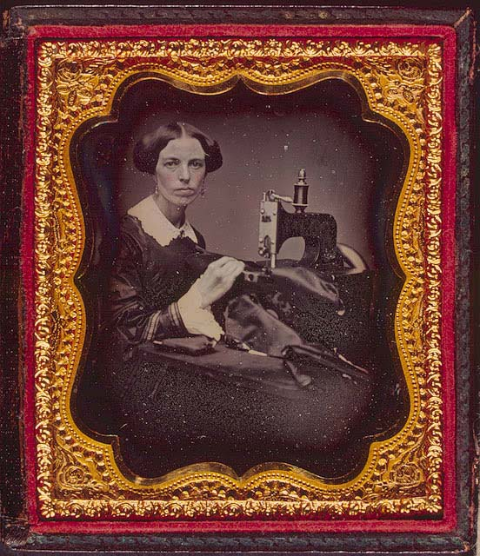
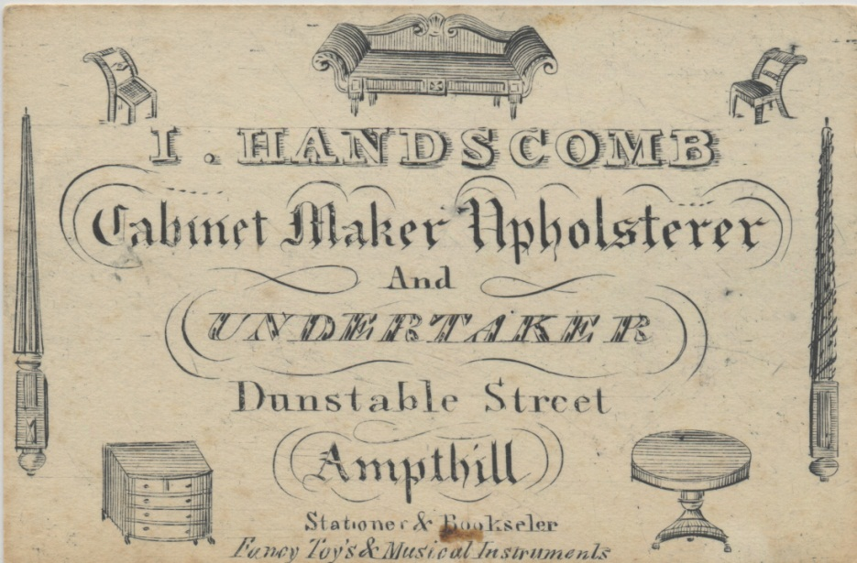
Many Germans worked at skilled labor such as tailors, seamstresses, bricklayers, cabinet makers, bakers and food merchants

Slide 16
Anti-Immigration Movements
Industrialization and Immigration greatly changed the American labor force
Industrial jobs in the Northeast attracted many people
Many native born workers feared losing their jobs to incoming immigrants who were willing to work for lower wages

Slide 17
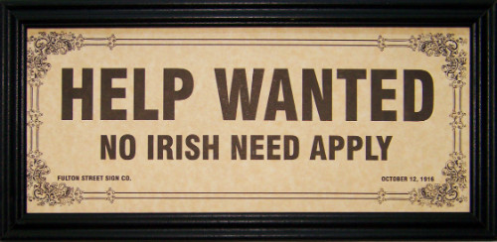
Some where threatened by the immigrants culture and religion

Slide 18
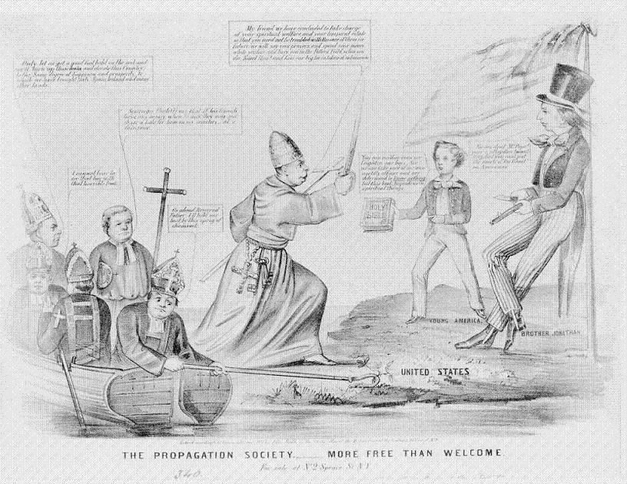
Americans also mistrusted Catholic immigrants because of the history of conflict between European Protestants and Catholics

Slide 19
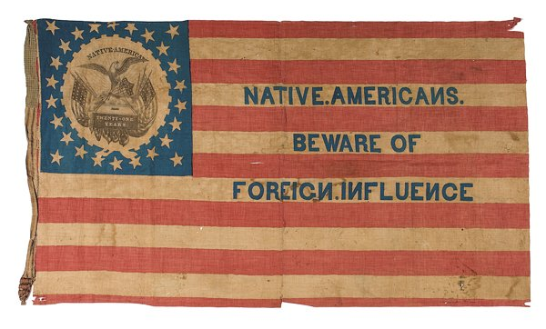
“No Irish Need Apply”
Americans and others who opposed immigration were called nativists
In 1849 nativists founded a political the Know-Nothing Party, which tried to limit immigration

Slide 20
Rapid Growth of Cities
The Industrial Revolution led to the new jobs being created in American cities
The Transportation Revolution helped connect the cities
The rise of Industry and the growth of Cities changed American life
¾ of the countries manufacturing jobs were in cities of the Northeastern and Mid-Atlantic States
Small business owners and skilled workers profited most from the those changes
Merchants, manufacturers, professionals, and master craftsmen made up the new Middle Class
Cities afforded opportunity for entertainment and enriched cultural life like libraries, clubs and theatre

Slide 21
Urban problems
American cities in mid 1800’s faced many challenges due to rapid growth
Public and private transportation was limited
Because wages were so low many people could only afford to live in Tenements
Tenements were poorly designed apartment buildings that were dirty over crowded and unsafe
Lack of Public Health regulations
High crime rates and fires also plagued fast growing cities in the US

Slide 22
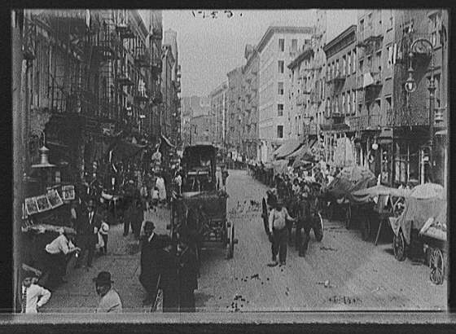
Public and private transportation was limited

Slide 23
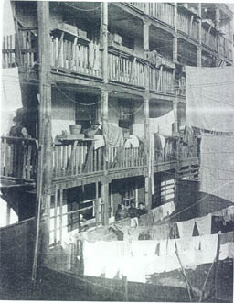
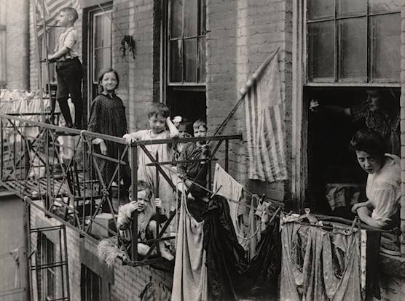
Because wages were so low many people could only afford to live in Tenements

Slide 24
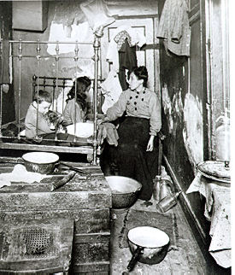
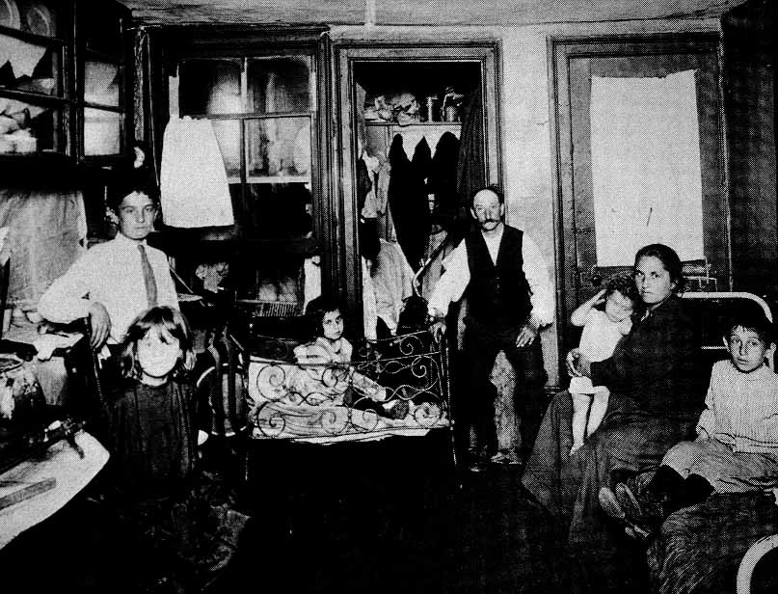
Tenements were poorly designed apartment buildings that were dirty over crowded and unsafe

Slide 25
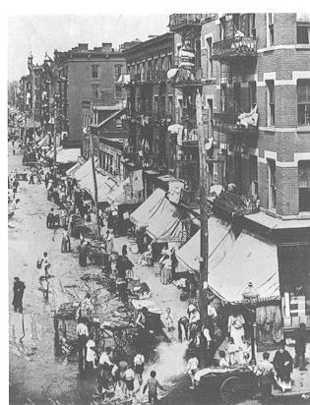
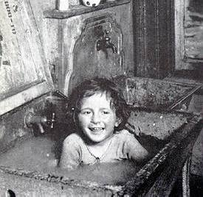
Lack of Public Health regulations
Did not have clean water
No effective waste & trash removal
Cholera and other epidemics were widespread

Slide 26
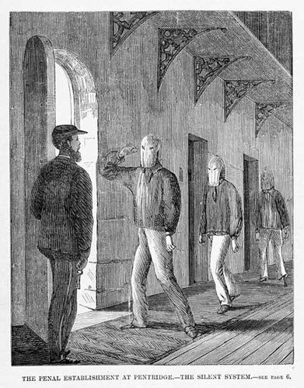
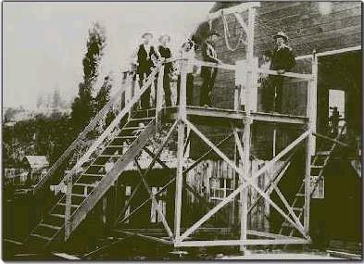
High crime rates and fires also plagued fast growing cities in the US

Slide 27
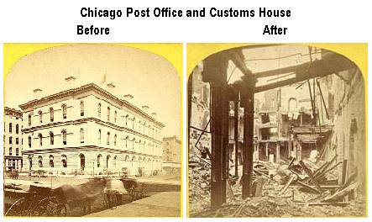
The Great Chicago Fire of 1861

Slide 28
Review
Urban cities grew rapidly -¾ of the countries manufacturing jobs were in cities of the Northeastern and Mid-Atlantic States
Urban problems included tenement housing, high crime rates, a lack of public health regulations, limited public transportation

Slide 29
American Arts
Section 2 p443-447
KEY TERMS:
Transcendentalism: belief people could transcend the material things in life
Transcendental writers: Ralph Waldo Emerson, Margaret Fuller, Henry David Thoreau
Utopian Communities: groups of people who tried to form a perfect society
Romantic Writers: Nathaniel Hawthorne, Herman Melville
Romantic Poets: Edgar Allen Poe, Emily Dickenson, Walt Whitman,
Henry Wadsworth Longfellow

Slide 30
Transcendentalists
Transcendentalism was a belief system in which followers thought they could rise above the material things in life
Transcendentalists believed that people should depend on themselves rather than outside authority.

Slide 31
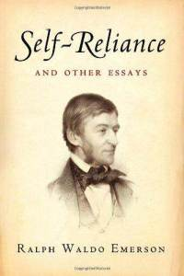
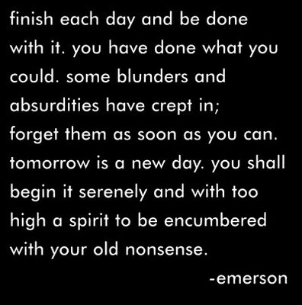
Transcendentalists
Ralph Waldo Emerson expressed his ideas in the essay “Self- Reliance”

Slide 32
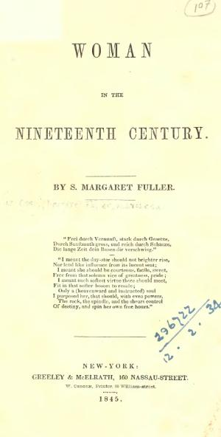
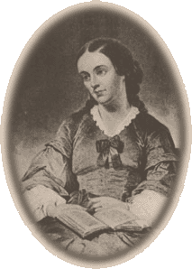
Transcendentalists
Margaret Fuller wrote Women in the Nineteenth Century, a book about women’s basic rights

Slide 33
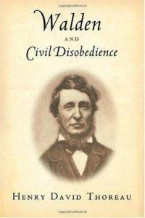
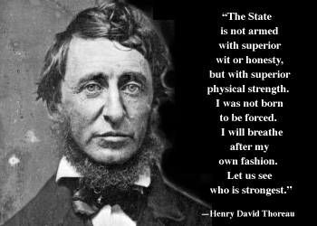
Transcendentalists
After living for 2 years in the woods Henry David Thoreau advised simple living and self reliance in his book Walden
He also wrote Civil Disobedience

Slide 34
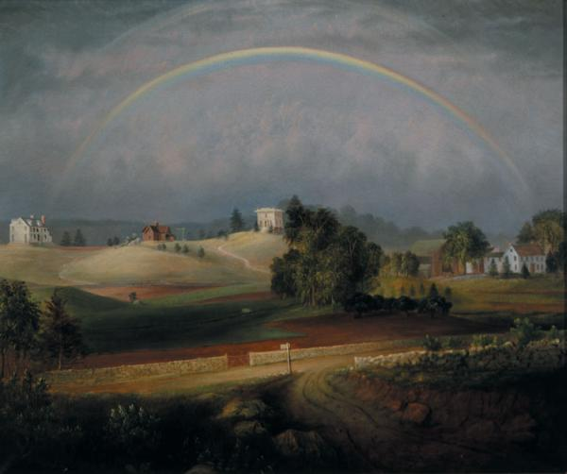
The Utopian community at Brook Farm in Massachusetts influenced the social reform movements of its day. Though it ended in bankruptcy it influenced a generation of intellectuals
Notes:
Founded by Unitarian minister George Ripley. Founded 1841 went bankrupt 1847 influenced many of the social reform movements of its day: abolitionist, workingman’s movement women’s rights. Emerson, Fuller & Thoreau declined to live there
Although it passed away with little more than a whimper, Brook Farm cannot be considered a failure. It profoundly affected the lives of almost everyone it touched: the residents, the children educated there, and the individualistic supporters. Hawthorne based the satiric novel, The Blithesdale Romance, 1852, on his experience there. Brook Farm left an indelible mark on American history, and remains a model for intentional communities throughout the world.
http://www25.uua.org/uuhs/duub/articles/brookfarm.html

Slide 35
American Romanticism
Romanticism
Each person is capable of achieving greatness and success in life.
Each person brings a unique view to the world and emotion should guide creativity.
Society is full of corruption and nature provides the only true safe-haven in the world.
The uniqueness of the individuals perspective and emotions and celebration of nature and simple life
Notes:
Romanticism A. involved a great interest in the simplicity of Nature B. an emphasis on individual expression C. rejection of established rules

Slide 36
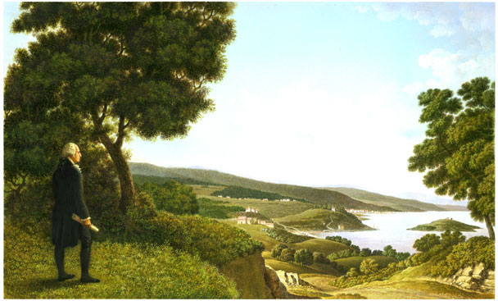
American Romantic Painters
Bagram Ibatoulline
From the Foundation Up

Slide 37
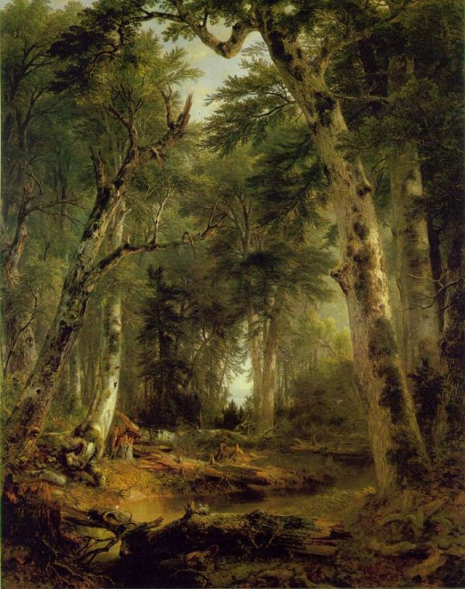
Hudson River School
Group of New York City based Lanscape Artists
Started around 1850
Influenced by the romantic movement
reflect three themes of America in the 19th century: discovery, exploration, and settlement.
An America were humans and nature coexist peacefully.
Caracterized by their realistic, detailed, and sometimes idealized portrayal of nature
Asher Durand
In the Woods, 1855

Slide 38
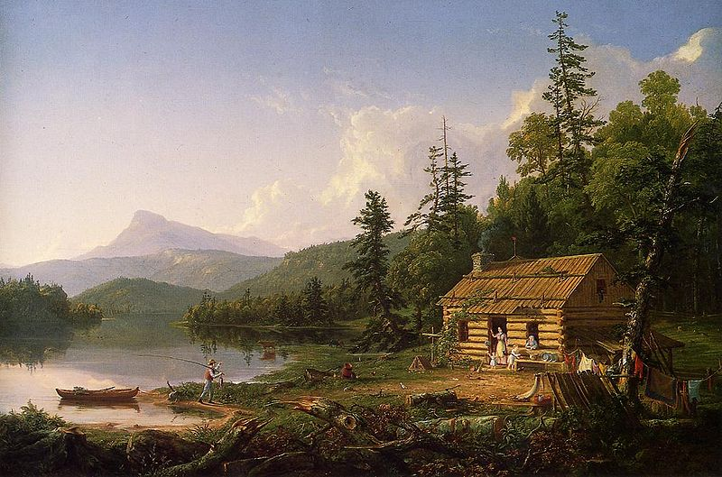
Thomas Cole
Home in the Woods, 1847

Slide 39
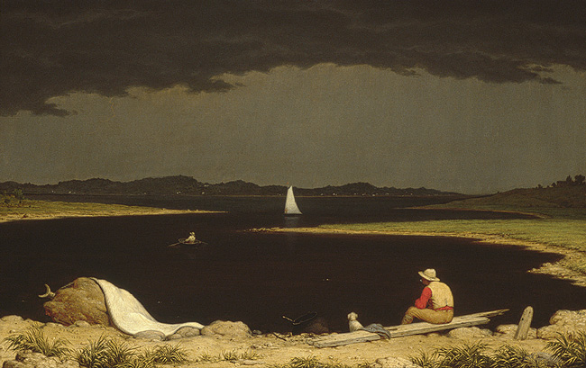
Martin Johnson Heade
Approaching Thunder Storm, 1859

Slide 40
Romantic Writers & Poets
Nathaniel Hawthorne – The Scarlet Letter
Herman Melville – Moby Dick
Edgar Allen Poe – The Raven
Emily Dickinson - poetry
Henry Wadsworth Longfellow – Song of Hiawatha
Walt Whitman Leaves of Grass
to praise American individualism and democracy.

Slide 41
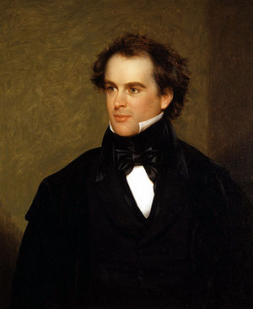
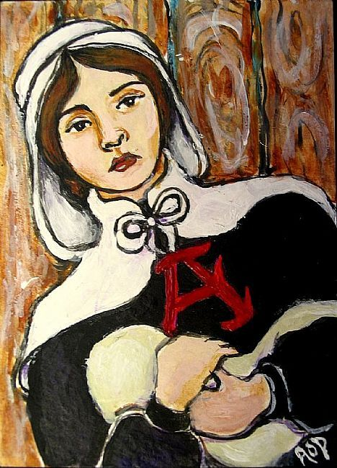
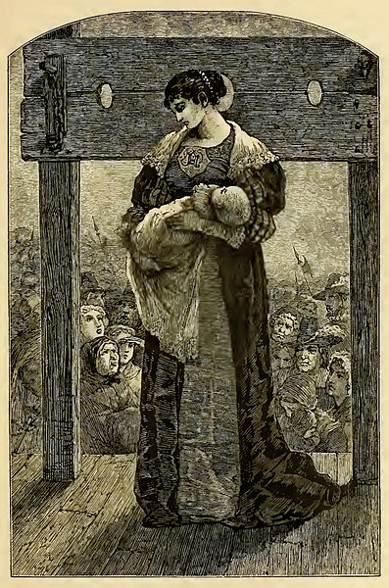
Nathaniel Hawthorne - The Scarlet Letter
Nathaniel Hawthorne –
The Scarlet Letter
Considered one of the Great American Novels
Notes:
Hester Prynne, has been led from the town prison with her infant daughter in her arms, and on the breast of her gown "a rag of scarlet cloth" that "assumed the shape of a letter." It is the uppercase letter "A.“ Hester's husband, who is much older than she, and whose real name is unknown, has sent her ahead to America whilst settling affairs in Europe while waiting for her husband, Hester has had an affair, She will not reveal her lover's identity, however, and the scarlet letter, along with her subsequent public shaming, is the punishment for her sin and secrecy
The elderly onlooker is Hester's missing husband, who is now practicing medicine and calling himself Roger Chillingworth. He reveals his true identity to Hester.
Community officials attempt to take Pearl away from Hester, but with the help of Arthur Dimmesdale, an eloquent minister, the mother and daughter manage to stay together. Dimmesdale, however, appears to be wasting away and suffers from mysterious heart trouble, Dimmesdale's psychological anguish deepens, and he invents new tortures for himself
The former lovers decide to flee to Europe, where they can live with Pearl as a family. They will take a ship sailing from Boston in four days. Both feel a sense of relief, and Hester removes her scarlet letter and lets down her hair. The sun immediately breaks through the clouds and trees to illuminate her release and joy. Pearl, playing nearby, does not recognize her mother without the letter. She is unnerved and expels a shriek until her mother points out the letter on the ground. Hester beckons Pearl to come to her, but Pearl will not go to her mother until Hester buttons the letter back onto her dress. Pearl then goes to her mother. Dimmesdale gives Pearl a kiss on the forehead, which Pearl immediately tries to wash off in the brook, because he again refuses to make known publicly their relationship. However, he clearly feels a release from the pretense of his former life, and the laws and sins he has lived with.
Knowing his life is about to end, he mounts the scaffold with his lover and his daughter, and confesses publicly, exposing the mark supposedly seared into the flesh of his chest. He dies in Hester's arms after Pearl kisses him.^{[2]}
Chillingworth dies within the year. Hester and Pearl leave Boston, Many years later, Hester returns alone. When Hester dies is buried next to dimmesdale, Yet one tombstone served for both." The tombstone was decorated with a letter "A", for Hester and Dimmesdale.

Slide 42
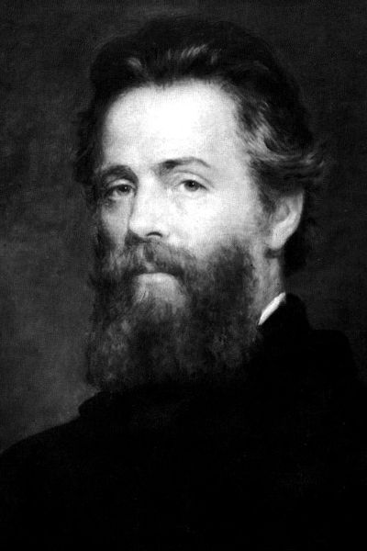
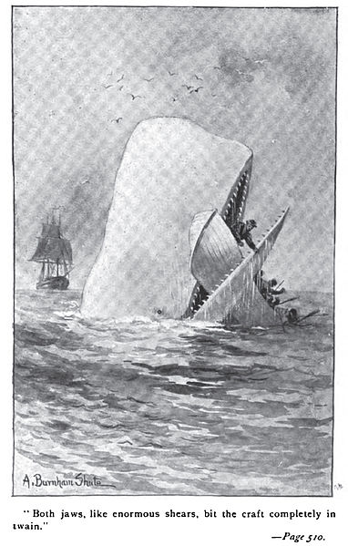
Herman Melville – Moby Dick
“Call Me Ishmeal”
Considered one of the Great American Novels
Notes:
When his bunk mate, a heavily tattooed Polynesian harpooner named Queequeg, returns very late and discovers Ishmael beneath his covers, both men are alarmed, but the two quickly become close friends and decide to sail together from Nantucket, Massachusetts on a whaling voyage.
In Nantucket, the pair signs on with the Pequod, a whaling ship that is soon to leave port. The ship’s captain, Ahab,
The ship’s officers direct the early voyage while Ahab stays in his cabin. The chief mate is Starbuck, a serious, sincere Quaker and fine leader; second mate is Stubb, happy-go-lucky and cheerful and always smoking his pipe; the third mate is Flask, short and stout but thoroughly reliable. Each mate is responsible for a whaling boat, and each whaling boat of the Pequod has its own pagan harpooneer assigned to it
Ahab secures their support for his single, secret purpose for this voyage: hunting down and killing Moby Dick, an old, very large sperm whale, with a snow-white hump and mottled skin, that crippled Ahab on his last whaling voyage. charismatic but monomaniacal captain
The first mate argues repeatedly that the ship’s purpose should be to hunt whales for their oil, with luck returning home profitably, safely, and quickly, but not to seek out and kill Moby Dick in particular — and especially not for revenge.
the Pequod meets Moby Dick. For two days, the Pequod's crew pursues the whale, which wreaks widespread destruction, including the disappearance of Fedallah. On the third day, Moby Dick rises up to reveal Fedallah tied to him by harpoon ropes, clearly dead. Even after the initial battle on the third day, it is clear that while Ahab is a vengeful whale-hunter, Moby Dick, while dangerous and fearless, is not motivated to hunt humans
three boats sail out to hunt him, Moby Dick damages two of them, forcing them to go back to the ship and leaving only Ahab's vessel intact. Ahab harpoons the whale, but the harpoon-line breaks. Moby Dick then rams the Pequoditself, which begins to sink. As Ahab harpoons the whale again, the unfolding harpoon-line catches him around his neck and he is dragged into the depths of the sea by the diving Moby Dick. The boat is caught up in the whirlpool of the sinking ship, which takes almost all the crew to their deaths. Only Ishmael survives, clinging to Queequeg’s coffin-turned-life buoy for an entire day and night before the Rachel rescues him.

Slide 43
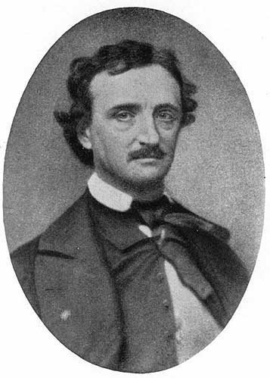
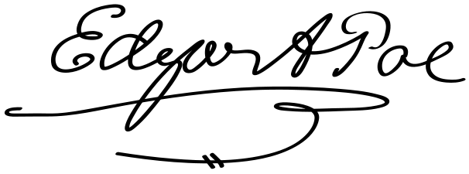
Edgar Allen Poe – The Raven
Notes:
The Raven" is a narrative poem by American writer Edgar Allan Poe. First published in January 1845, the poem is often noted for its musicality, stylized language, and supernatural atmosphere. It tells of a talking raven's mysterious visit to a distraught lover, tracing the man's slow descent into madness. The lover, often identified as being a student,^{[1][2]} is lamenting the loss of his love, Lenore. Sitting on a bust of Pallas, the raven seems to further instigate his distress with its constant repetition of the word "Nevermore". The poem makes use of a number of folk and classical references.

Slide 44
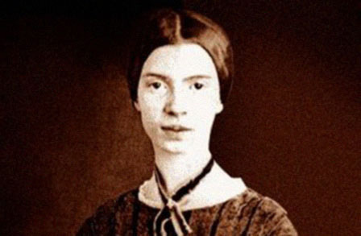
Emily Dickinson - poet
Notes:
A poet who took definition as her province, Emily Dickinson challenged the existing definitions of poetry and the poet's work
Thought of as an eccentric by the locals, she became known for her penchant for white clothing and her reluctance to greet guests or, later in life, even leave her room. Most of her friendships were therefore carried out by correspondence.
Although Dickinson was a prolific private poet, fewer than a dozen of her nearly eighteen hundred poems were published during her lifetime.^{[2]} The work that was published during her lifetime was usually altered significantly by the publishers to fit the conventional poetic rules of the time. Dickinson's poems are unique for the era in which she wrote; they contain short lines, typically lack titles, and often use slant rhyme as well as unconventional capitalization and punctuation.^{[3]} Many of her poems deal with themes of death and immortality, two recurring topics in letters to her friends.

Slide 45
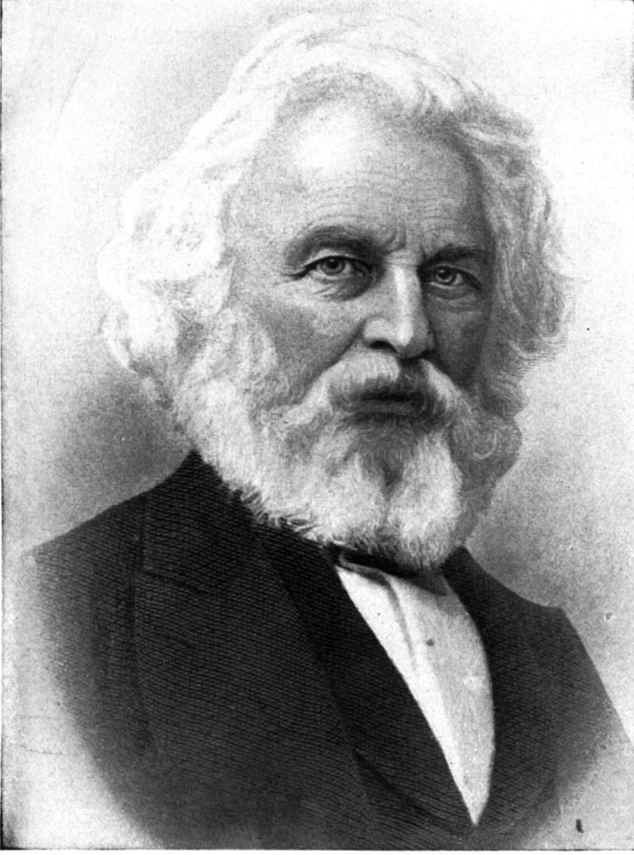
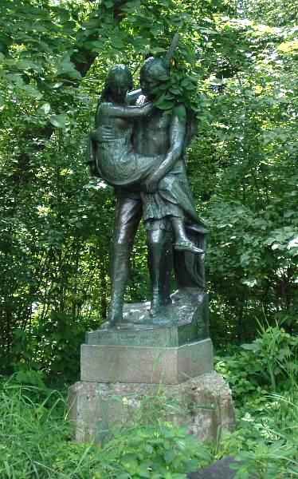
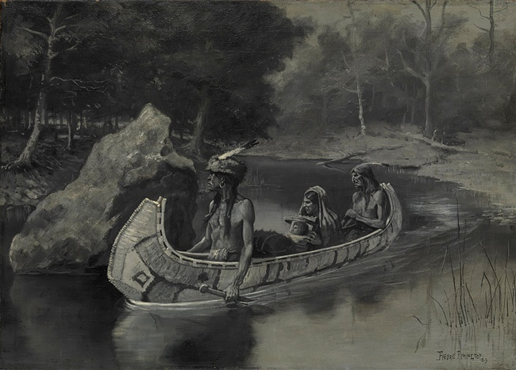
Henry Wadsworth Longfellow – Song of Hiawatha
"Music is the universal
language of mankind."
By the shores of Gitche Gumee,
By the shining Big-Sea-Water,
Stood the wigwam of Nokomis,
Daughter of the Moon, Nokomis
Statue of Hiawatha & Minnehaha
In Minneapolis, MN
Notes:
work of American Romantic literature, not a representation of Native American oral tradition
Ch 1-3 origin story of Iroquios
In the ensuing chapters Hiawatha has childhood adventures, falls in love with Minnehaha, slays the evil magician Pearl-Feather, invents written language, discovers corn and other episodes.
The poem closes with the approach of a birch canoe to Hiawatha's village, containing "the Priest of Prayer, the Pale-face." Hiawatha welcomes him joyously; and the "Black-Robe chief" brings word of Jesus Christ.
Hiawatha and the chiefs accept the Christian message. Hiawatha bids farewell to Nokomis, the warriors, and the young men, giving them this charge: "But my guests I leave behind me/ Listen to their words of wisdom,/ Listen to the truth they tell you." Having endorsed the Christian missionaries, he launches his canoe for the last time westward toward the sunset, and departs forever.

Slide 46
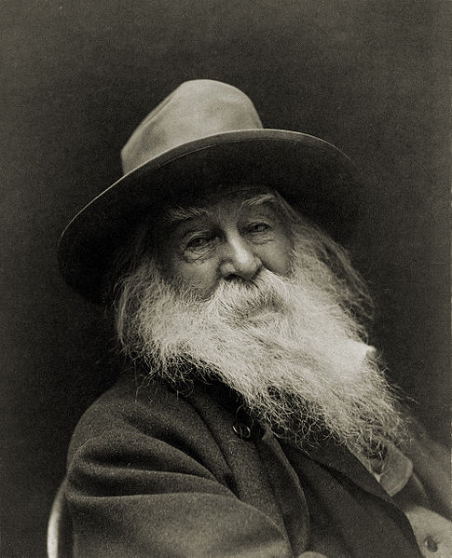
Walt Whitman Leaves of Grass
to praise American individualism and democracy.
“I am as bad as the worst, but, thank God, I am as good as the best. ”
“Do anything,
but let it produce joy.”
“Not I, nor anyone else can travel that road for you. You must travel it by yourself. It is not far. It is within reach. Perhaps you have been on it since you were born, and did not know. Perhaps it is everywhere - on water and land.”
“Resist much.
Obey little.”
Notes:
Whitman paid for the publication of the first edition of Leaves of Grass himself^{[43]} and had it printed at a local print shop during their breaks from commercial jobs.^{[44]}A total of 795 copies were printed
he calls himself "Walt Whitman, an American, one of the roughs, a kosmos, disorderly, fleshly, and sensual, no sentimentalist, no stander above men or women or apart from them, no more modest than immodest".
he first edition of Leaves of Grass was widely distributed and stirred up significant interest,^{[49]} in part due to Emerson's approval,^{[50]} but was occasionally criticized for the seemingly "obscene" nature of the poetry.^{[51]} Geologist John Peter Lesley wrote to Emerson, calling the book "trashy, profane & obscene" and the author "a pretentious ass".
n the months following the first edition of Leaves of Grass, critical responses began focusing more on the potentially offensive sexual themes. Though the second edition was already printed and bound, the publisher almost did not release it.

Slide 47
Review
Romanticism’s Tenets –
Each person is capable of achieving greatness and success in life.
Each person brings a unique view to the world and emotion should guide creativity.
Society is full of corruption and nature provides the only true safe-haven in the world.
Transcendentalism –
people should begin to follow their own beliefs and use their own judgment.
Ralph Waldo Emerson’s Self Reliance

Slide 48
Reforming Society
Section 3 p448-453
KEY TERMS
Second Great Awakening: Christian renewal movement of early 19th century (1800’s)
Charles Grandison Finney & Lyman Beecher
Temperance Movement: reform effort to spread abstinence from alcohol
Dorthea Dix: leader of prison reform movement
Education Reform: Horace Mann & Common-School Movement
Catherine Beecher & woman’s education movement
Thomas Gallaudet & special needs education

Slide 49
Second Great Awakening
During the 1790s, a period of Christian renewal began.
It was known as the Second Great Awakening.
By the 1830s, it had swept through New England, the Appalachians, and the South.
Charles Grandison Finney was one of the leaders of the Second Great Awakening.
Finney believed salvation is in the hands of the individual.

Slide 50
Opposition to the Second Great Awakening
Some like Minister Lyman Beecher, did not agree with Finney’s message.
The Constitution’s First Amendment guaranteed Finney’s right to speak and be heard.
Through the efforts of Finney and other ministers, many Americans joined churches across the country.

Slide 51
Social Reformers speak out
In the spirit of the Second Great Awakening, people tried to reform many of society’s ills.
Middle class women often led the efforts for Reform

Slide 52
Temperance Movement
In the temperance movement, people aimed at limiting alcohol consumption.
Lyman Beecher and other ministers spoke about the evils of alcohol.

Slide 53
Prison Reform
In 1841 Dorothea Dix, reported on the terrible conditions she found when she visited some Massachusetts prisons.
Imprisoned along with adult criminals were the mentally ill and children.
Because of efforts by Dix and others, governments built hospitals for the mentally ill and reform schools for young lawbreakers.
They also began to try to reform—not just punish—prisoners.

Slide 54
Improvements in Education
In the 1800’s most children received some learning but public school education varied widely
New England had the most schools, South & West the fewest
McGuffey’s Readers were the most popular textbooks.
They had selections of British and American literature, readings, and moral and value lessons
Social background and wealth affected the quality of education
Wealthy - private schools and tutors
Poor – public education
Whether wealthy or poor, few girls learned to read

Slide 55
Common-School Movement
Education in the early 1800s improved with the common-school movement.
This movement, led by Horace Mann, worked to have all students, regardless of background, taught in the same place.

Slide 56
Women’s Education
Women’s education also improved at this time.
Several women’s schools, including Catherine Beecher’s all-female academy in Hartford Connecticut, opened.

Slide 57
Teaching People with Special Needs
Teaching people with disabilities improved, too. For example, Thomas Gallaudet bettered the education of the hearing impaired.

Slide 58
African American Communities
Free African Americans usually lived in segregated communities in the North.
The Free Africans Religious Society, founded by Richard Allen, pressed for equality and education of Blacks.
In 1816 Richard Allen became the first Bishop of the AME Church
African Methodist Episcopal Church

Slide 59
African American Education
Leaders such as Alexander Crummel helped build African American schools in New York, Philadelphia, Boston and other cities
In 1835 Oberlin College became the first college to admit African Americans.
Soon after, in the 1840s, several African American colleges were founded.
While Free African Americans had some educational opportunity in the North and Midwest, few had the opportunity in the South

Slide 60
Review
Second Great Awakening- Christian renewal and revival that began in the northeastern U.S.
Charles Grandison Finnley – believed salvation is in the hands of the individual.
Temperance movement – goal of limiting the consumption of alcohol in America
Dorthea Dix – prison reformer who spoke of horrible conditions of prisons and advocated separate facilities for mentally ill

Slide 61
The Movement to End Slavery
Section 4 p454-459
KEY TERMS & PEOPLE:
Abolition: movement to abolish slavery
American Anti-Slavery Society:
group advocating immediate emancipation and racial equality for African Americans
William Lloyd Garrison – founder and president
Angelina and Sarah Grimke: Sisters who were White Southern anti-slavery activists
Fredrick Douglas: escaped slave & African American Leader
Sojourner Truth: former slave, abolitionist & women’s rights activist
Harriet Tubman: Conductor on Underground Railroad who freed +300 slaves
Underground Railroad: network of people who helped fugitive slaves escape north

Slide 62
Differences among Abolitionists
By the 1830s, many Americans formed a movement to end slavery.
Abolitionists worked for emancipation, or freedom from slavery, for all who lived in the United States.
Quakers were among the first groups to challenge slavery on religious grounds
Some abolitionists thought that ex-slaves should get the same rights enjoyed by other Americans.
Others, however, hoped to send the freed blacks back to Africa to start new colonies there.
In 1822The American Colonization Society successfully founded the African colony of Liberia.

Slide 63
Differences among

Slide 64
Spreading the Abolitionist Message
Many abolitionists spread the message of abolition using the power of the pen.
William Lloyd Garrison
ran The Liberator newspaper.
founded the American Anti-Slavery Society.
believed in emancipation and racial equality.
Angelina and Sarah Grimké were two sisters from a southern slave-holding family.
They wrote pamphlets and a book to try to convince other white people to join the fight against slavery.

Slide 65
Fredrick Douglass
When Frederick Douglass was a slave, he secretly learned to read and write.
He escaped slavery when he was 20
Douglas became one of the most important African American leaders of the 1800’s
He was a powerful speaker who vividly described slavery’s horrors
He published the newspaper The North Star and writing many books about his life.

Slide 66
Sojourner Truth
Sojourner Truth who became famous for her anti-slavery speeches.
She claimed God called her to travel through the US and preach the truth about slavery and women’s rights

Slide 67
The Underground Railroad
The Underground Railroad was the name given a loosely knit group of white and black abolitionists who helped escaped slaves get North to freedom.
Despite any real structure the Railroad managed to achieve dramatic results
Escaped slaves traveled by night with sometimes only the stars to tell the way, and rested during daylight hours
Conductors guided escaping slaves to stations (safe houses) operated by station masters (abolitionists) where they could rest & get food before continuing on their way North

Slide 68
Harriet Tubman
One of the most famous “conductors” on this Railroad was an ex-slave named Harriet Tubman.
She made 19 trips to the north, freeing more than 300 slaves
Reward for her capture was set at $40,000

Slide 69
Opposition to Abolition
The North was the center of the Abolitionist movement, but there were some in the North who sympathized with the South
Some newspapers and politicians used fear of freed slaves taking jobs in the North to increase opposition to abolition
Federal government instituted the gag rule to stop congress from debating slavery question

Slide 70
Many white southerners felt slavery was vital to their economy.
They also felt that outsiders should not tell them what to do.
Some justified enslaving people by claiming that African Americans needed the structure of slavery to survive.
Racism, fear and economic dependence on slavery made emancipation all but impossible in the South

Slide 71
Review
William Ll0yd Garrison - He founded and ran an anti- slavery newspaper called the Liberator

Slide 72
Women’s Rights
Section 5 p461-466
KEY TERMS and PEOPLE:
Seneca Falls Convention: 1st public meeting about women’s rights held in the US
Declaration of Sentiments: treatise stating beliefs about social injustice toward women
Leaders of the fight for Women’s Rights:
Elizabeth Cady Stanton
Lucretia Mott
Lucy Stone
Susan B. Anthony

Slide 73
Women’s struggles for equal rights
In the mid-1800s, some female abolitionists also began to focus on the women’s rights in America
The Grimké sisters were criticized for speaking in public. Their critics felt they should stay at home.
Sarah Grimké responded by writing a pamphlet in support of women’s rights.
She also argued for equal educational opportunities, as well as for laws that treated women in an equal manner.

Slide 74
Margaret Fuller
Transcendentalist Margaret Fuller published Woman in the 19th Century, a book which helped influence many leaders of the Women’s rights movement
It stated that women should be able to make independent choices about their lives
Many women realized that the principles behind abolition were identical to women’s rights principles

Slide 75
Sojourner Truth
Abolitionist Sojourner Truth also became a women’s-rights supporter.
She took the name Sojourner Truth because she thought it was her duty to traveler and spread the truth
The ex-slave never learned to read or write, but she became a great and influential speaker.

Slide 76
The Movement Grows
Changes in the 1800’s helped fuel the women’s rights movement
Women’s active leadership in the abolition movement
The increase in educational opportunities
Reform group work taught them how to be organized and work together
Reform group work also got men involved in women’s rights movement

Slide 77
Why Women wanted equality
Women were not allowed to vote or sit on juries
In many states married women had little to no control over their own property
Women crusaders were not given the same respect as their male counterparts

Slide 78
Opposition to women’s rights
The women’s movement had many critics—both men and women.
Some felt a woman should stay home.
Others felt women were not as physically or
mentally strong as men.
Therefore, they needed the protection of first their fathers, then their husband
This was why upon marriage, husbands took control of their wives’ property.

Slide 79
Seneca Falls Convention
With the support of leaders like Elizabeth Cady Stanton and Lucretia Mott, the Seneca Falls Convention opened July 19, 1848, in Seneca Falls, New York.
It began the organized women’s rights movement in the U.S.
It resulted in the Declaration of Sentiments.
officially requested equality for women.
It used the Declaration of Independence as its template
It brought 18 charges against men, much as the Declaration of Independence had brought 18 charges against King George III.

Slide 80
Women’s Rights Leaders
3 major women’s rights leaders, each brought different strengths to the fight for women’s rights
Lucy Stone –Susan B. Anthony -

Slide 81
Lucy Stone
gifted orator &spokesperson for the Anti-Slavery Society and the women’s rights movement

Slide 82
Susan B. Anthony
who argued for equal pay for equal work,
the right of women to enter traditionally male professions
Equal property rights for women

Slide 83
Elizabeth Cady Stanton
Founder and leader of National Women’s Suffrage Association
Radical because saw women’s rights as more important than abolition

Slide 84
Review
Lucretia Mott and Elizabeth Cady Stanton- organized the Seneca Falls Convention
Seneca Falls Convention - It began the organized women’s rights movement in the U.S.
Margaret Fuller wrote Woman in the 19th Century which said women be able to make independent choices about their lives

Slide 85
I went to the woods because I wished to live deliberately, to front only the essential facts of life, and see if I could not learn what it had to teach, and not, when I came to die, discover that I had not lived…. I wanted to live deep and suck out all the marrow of life, to live so sturdily and Spartan-like as to put to rout all that was not life, …..if it were sublime, to know it by experience, and be able to give a true account of it in my next excursion.
Walden
Henry David Thoreau

