Slide 1
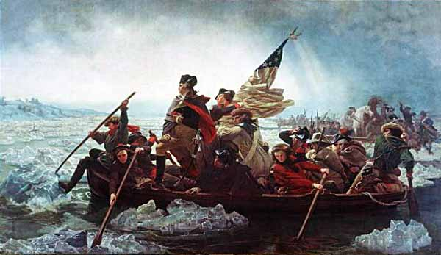
Ch 4
The American Revolution
Notes:
Following the Coercive Acts, the King sent General Thomas Gage to command the British troops and become Governor of Massachusetts
All trade ships were cut off from Boston
Any local boats were to be captured and destroyed
Many residents left Boston, but most remained
Flour, cattle, fish, and other food came pouring in from all over New England
The General Assembly of Mass. Met and proposed the Continental Congress

Slide 2
First Continental Congress
56 delegates
Carpenter’s Hall, Philadelphia
Middle-aged, well-educated, property owners
Intense debates whether to fight of seek peace
Notes:
Patrick Henry said “I am not a Virginian, but an American.”
Paul Revere rode into town with news: the Massachusetts Government had passed the Suffolk Resolves. This said they would collect their own taxes and keep them from the King until the Coercive Acts are repealed.
Colonists began to sabotage General Gage: sinking barges, burning the hay beds of soldiers, overturning wagons, stealing guns and powder
Militia began organizing and training

Slide 3
Encouraged peaceful boycotts of British goods
Began preparing for war
Drafted a Declaration of Rights

Slide 4
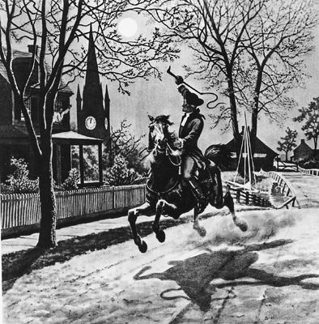
Battles of Lexington and Concord
More British troops arrive in Boston
More American Militia are being organized
Notes:
4,000 British troops
16,000 citizens
British troops were shooting at targets down by the Bay. None could hit the target. A farmer laughed at them and was challenged to hit the target. They loaded 5 muskets for him, but he said he only needed one. He hit the target and said he had a boy at home that outshoot them also.

Slide 5
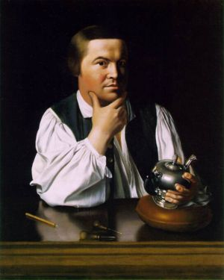
Notes:
Many British officers were deserting due to poor pay, rotten food, offers of land and a new start.
Gage ordered punishment for deserters
Normal punishment would be hanging, but he could not afford to lose any more officers
1,000 lashes, at 250 per week

Slide 6
Battles of Lexington and Concord
Gage learned of a military arsenal in Concord
Sent troops to capture the weapons
Spies were aware of Gage’s plan

Slide 7
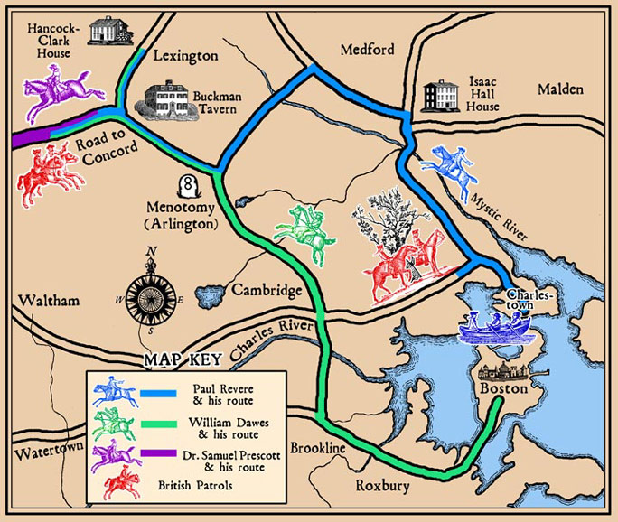

Slide 8
Revere and others got the lantern signal from the Old North Church
They rode through the countryside yelling “the regulars are coming!”
Revere was captured by British troops and later released
Notes:
Three men rode out
Revere and Dawes were captured, but took off on the soldiers
Dawes was able to escape, but Revere was captured again
With a gun pointed to his head, Revere told them of the plan and was then released

Slide 9
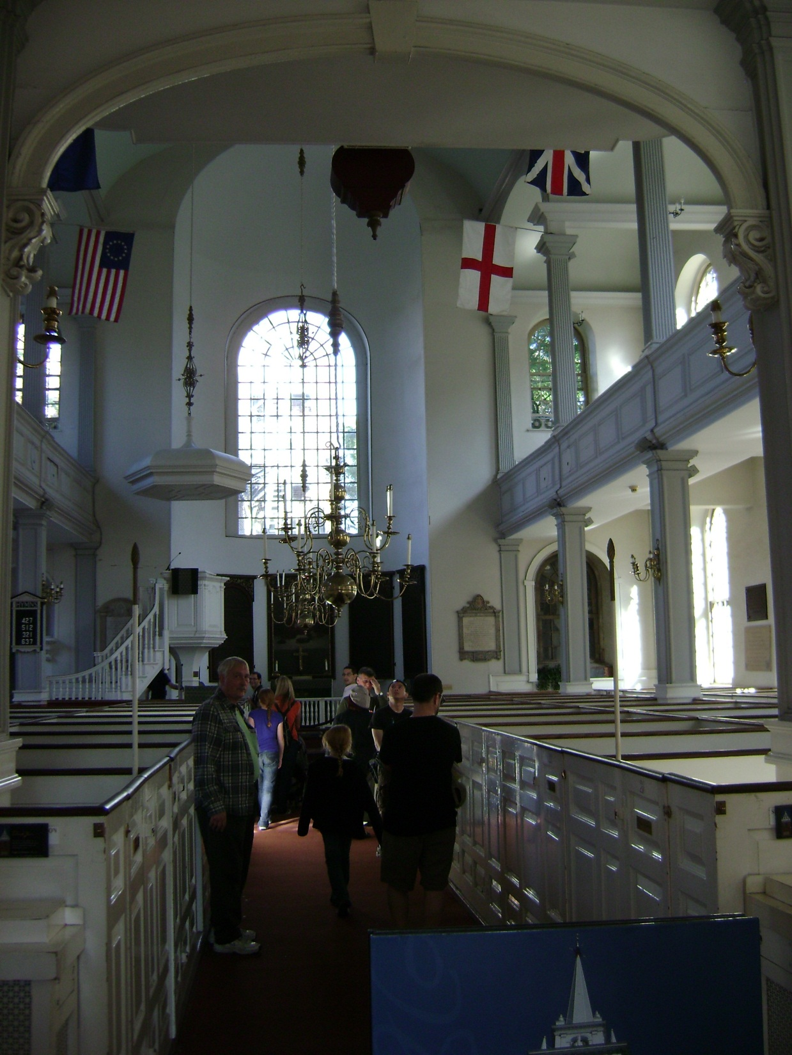

Slide 10
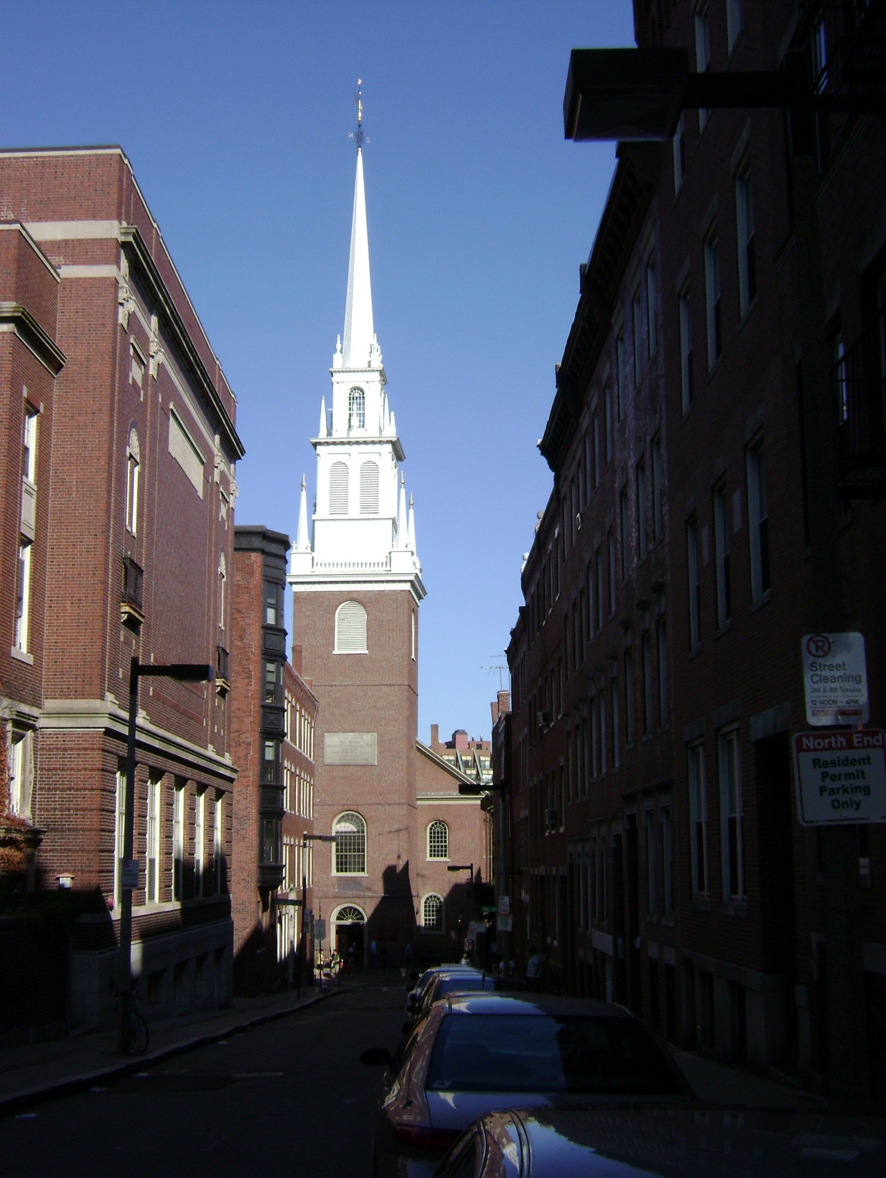

Slide 11
Seventy armed minutemen waited for the British at Lexington
A British officer yelled “fire!” and the shooting started
Militia ran
Redcoats continued their last six miles to Concord

Slide 12
Alarm bells rang in Concord
British soldiers took what they could find and tried to burn the rest
British were getting surrounded and had to retreat back to Boston
Notes:
Fighting again broke out as the redcoats were leaving Concord
As they march back to Boston, the British are fired on from all sides as more countrymen arrive
The British begin to run and fire back
The British doubled back and attacked from behind
The British attacked Americans in their houses and skewered them with their bayonets
The Americans kept coming
Each time an American was killed, two more arrived to take his place
The British are exhausted from marching for 20 hours

Slide 13
Second Continental Congress
Major contributions
of
Second Continental
Congress
Organized an army
and
Appointed
George Washington
Commander of
Continental Army
Offered Olive Branch
Petition
Decided to issue
Paper money to pay
conflicts
Enlisted service of
Experienced European
Military officers
Introduced the
Articles of
Confederation

Slide 14
After the Battles of Lexington and Concord, the two armies faced off in Boston
"Don't fire until you see the whites of their eyes.“
Battle of Bunker Hill was fought on Breed’s Hill

Slide 15
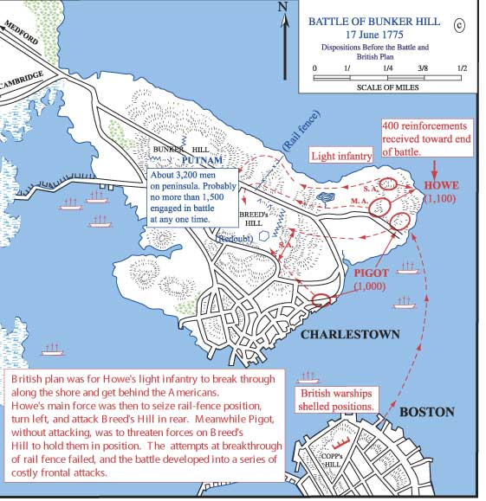

Slide 16
Battle of Bunker Hill
Two attacks of the hill were turned back
Americans were soon running out of ammunition
On third attack the British succeeded in overrunning them
Most of the Americans were able to withdraw
Thirty were caught and killed by the British
Notes:
Americans wanted to be on higher ground
Harbor was full of British warships
Americans built a fortified redoubt 160 ft long and 80 ft wide
Better farmers than they were soldiers
Worked all through the night
British woke to see a wall 6 feet high and 1 foot thick, 50 yards in length
British warships began to bomb away
Men wanted to save their rum and water, Asa Pollard had his head taken off
With no luck, they move in
Some that deserted were hanged
British officers whipped the reluctant ones with their swords

Slide 17
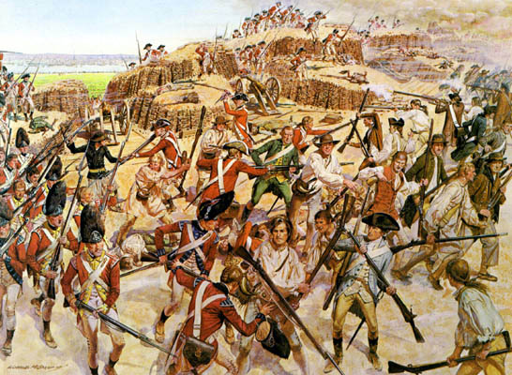
Battle of Bunker Hill
British casualties were 1000
American casualties were 450

Slide 18
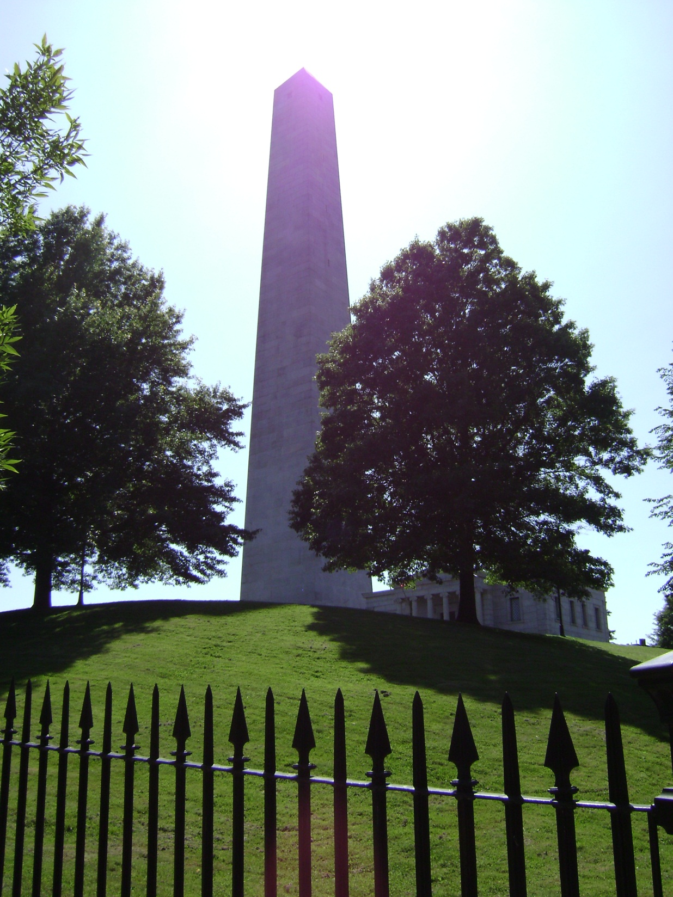

Slide 19
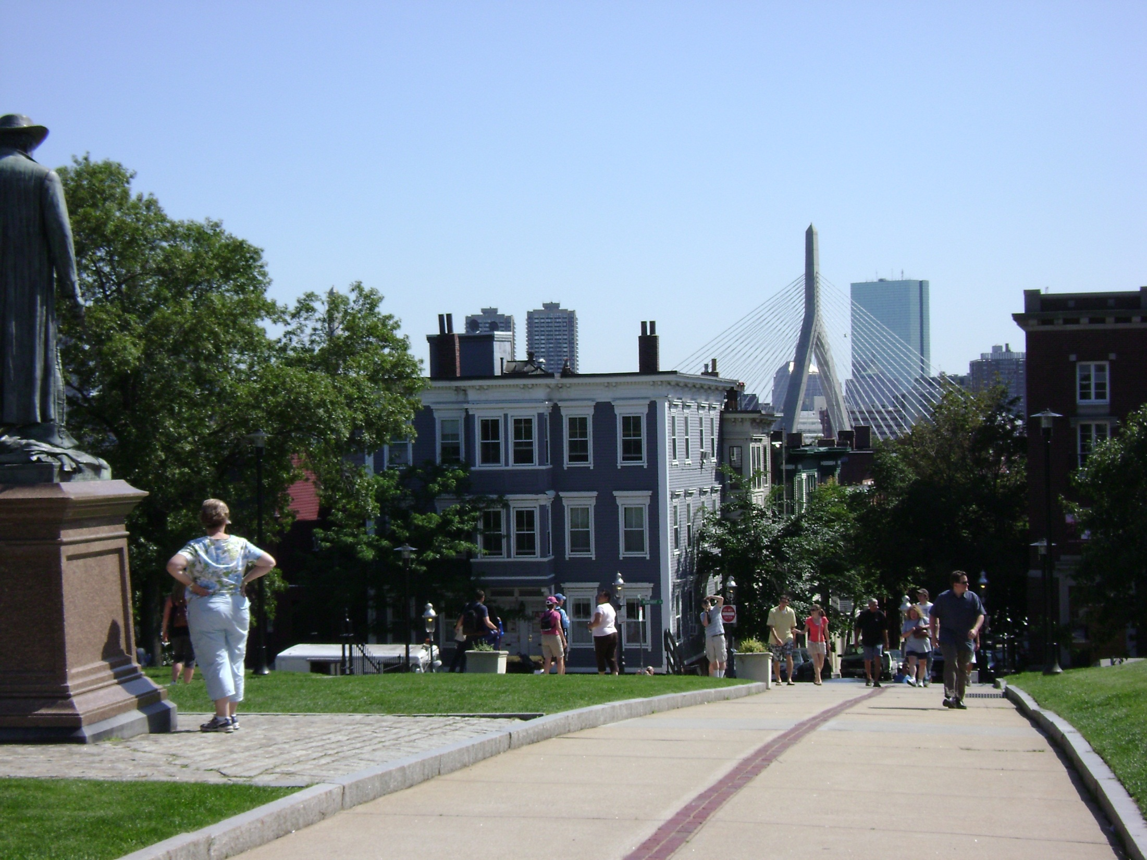

Slide 20
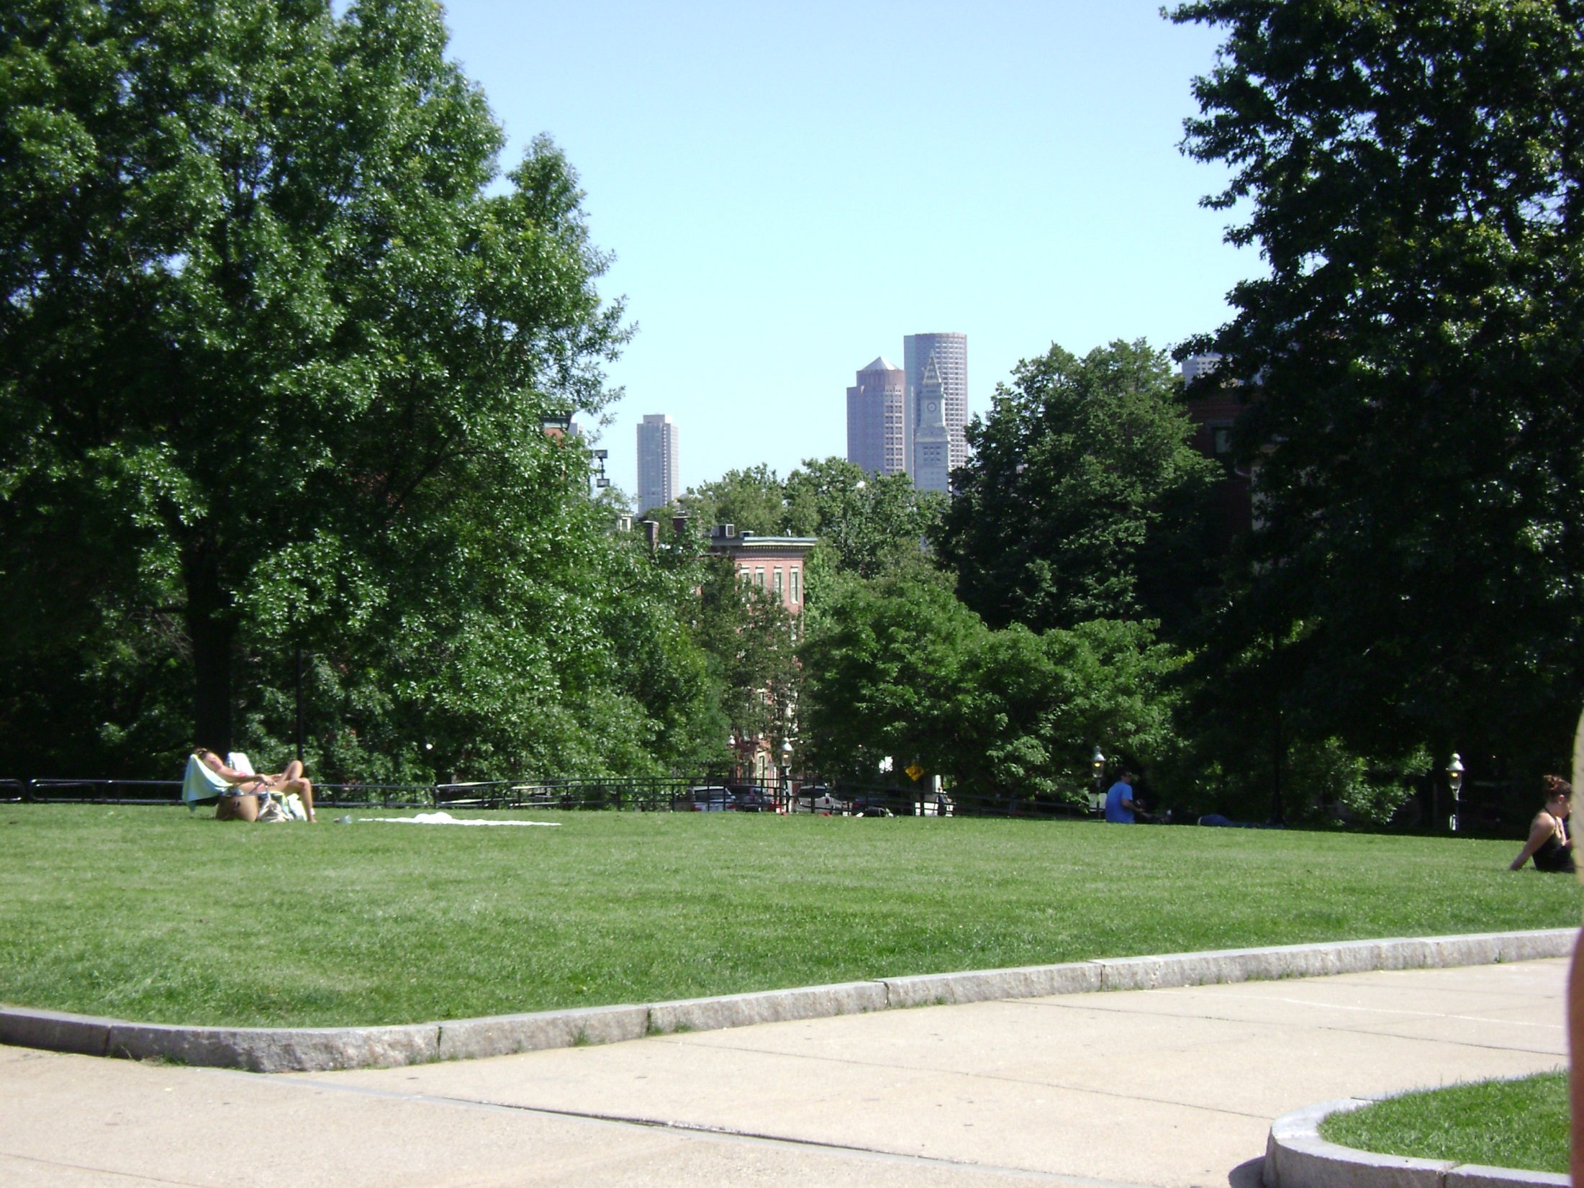

Slide 21
Dorchester Heights
Washington had the guns from Fort Ticonderoga brought in.
Henry Knox brought 59 guns 300 miles.
Washington took Dorchester Heights and the British left Boston.
Notes:
Washington sent John Knox to get the guns at Fort Ticonderoga
Guns ranged from 4 to 20 pounders
Ranged from from 1 foot to 11 feet in length
Total of 119,000 lbs.
Left to get the guns on December 9
Total trip took 6 weeks
Brought through the mountains and across frozen rivers
Demonstrate how they got through mountains
Cut holes in the frozen rivers to make them stronger

Slide 22
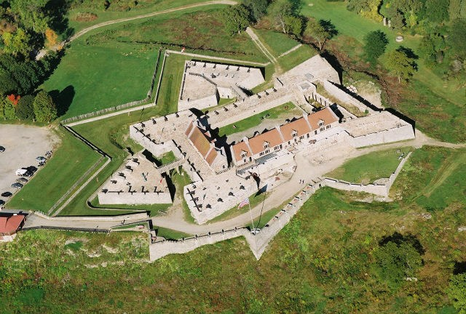

Slide 23
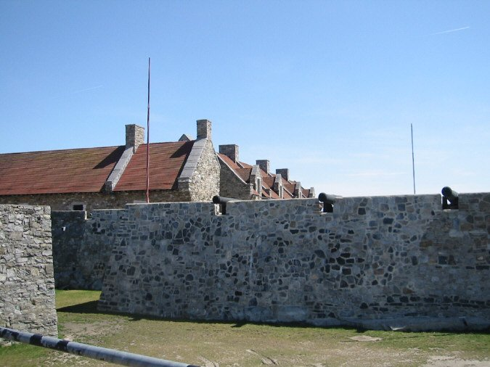

Slide 24
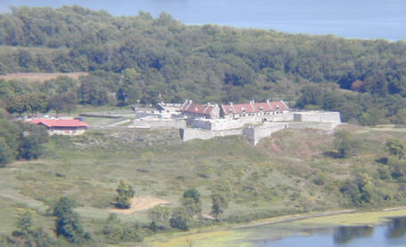

Slide 25
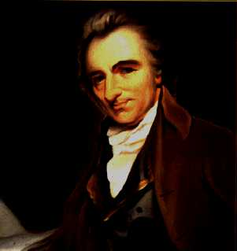
Common Sense
Common Sense was the most influential political pamphlet ever written.
Common Sense was written for the ‘common man’; men who would shed their blood in the rebellion.
Notes:
Paine was brutal toward the King and toward the idea that things would end well
If he had argued calmly and reasonably, he would not have been inspiring
He had to inspire the ‘common man’ to reach for the musket above the fireplace
Common Sense reached across the seas and was translated into French, Dutch, and German
Within 3 months 120,000 copies were sold
Read by as many as a million people

Slide 26
Declaring Independence
Common Sense - huge impact on hearts and minds of Americans.
On July 2, 1776, the Second Continental Congress declared independence from Great Britain.

Slide 27
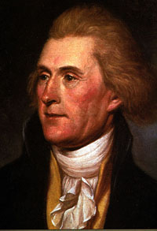
A 5 member committee prepared the Declaration
The Declaration was written by Thomas Jefferson
Notes:
Members included John Adams, Benjamin Franklin, Roger Sherman, Robert Livingston, and Thomas Jefferson
Jefferson was the least likely choice
At 33, he was the youngest delegate at Philadelphia
Adams or Franklin seemed to be the logical choice
Adams was actually first believed to be the author of “Common Sense”

Slide 28
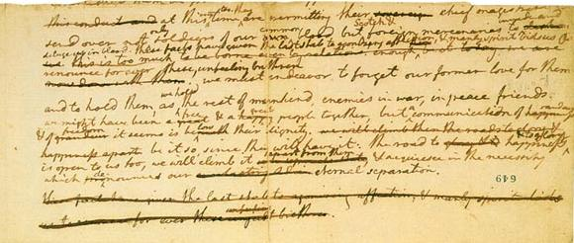

Slide 29
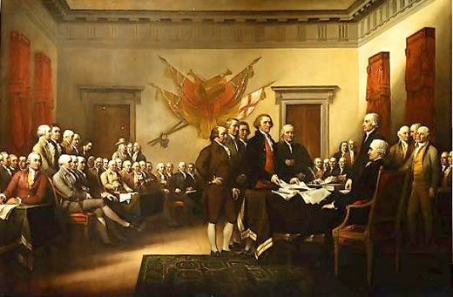
The Declaration was adopted on July 4, 1776.

