Slide 1
The Colonies at War
Benedict Arnold led an invasion of Quebec, Canada
General Montgomery captured Montreal, and then joined Arnold to attack Quebec
Patriots were badly beaten
Notes:
Arnold had a lot of disappointments
Had to return home from a battle to bury his wife
Ethan Allen was favored over him to command a fighting campaign
Mass. Leaders questioned the honesty of his military accounts
Congress accepted his advice and plans to invade Canada, but gave his command to someone else
After an interview with Washington, he was allowed to lead an invasion of Quebec
Fighting rapids, Arnold lost men along the river
They ran out of food, and ate soap, leather bullet pouches, and moccasins
Killed and ate dogs that were their traveling companions
Dropouts, slow deaths, deserters
One colonel refused to go on, and withdrew his 300 men
What was estimated to take 20 days, took 45
They were ragged, skin and bones, and bearded
Montgomery arrived with blankets and clothing and on the first snowfall they attacked
Montgomery was killed and Arnold was shot in the leg
No other troops in the world could have endured such conditions

Slide 2
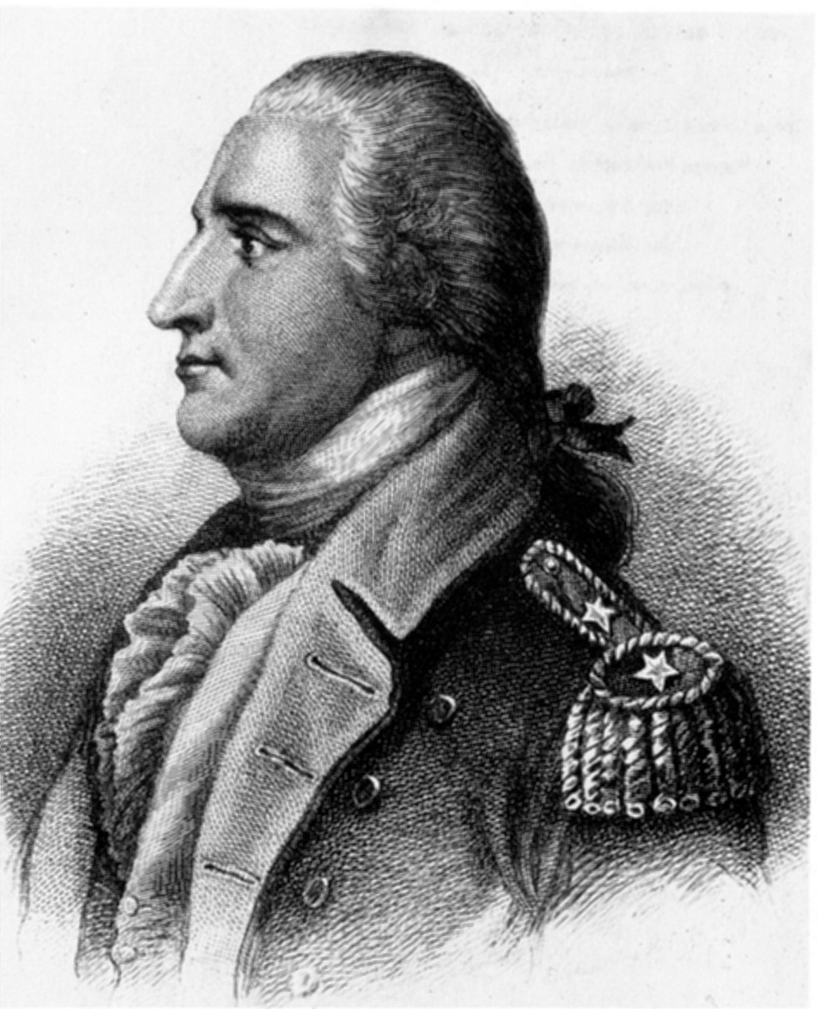

Slide 3
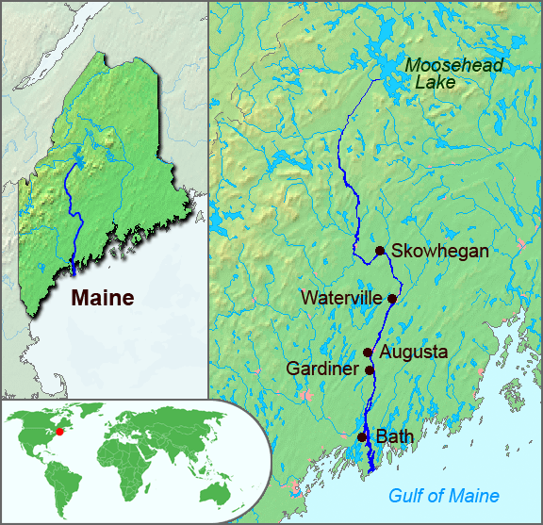

Slide 4
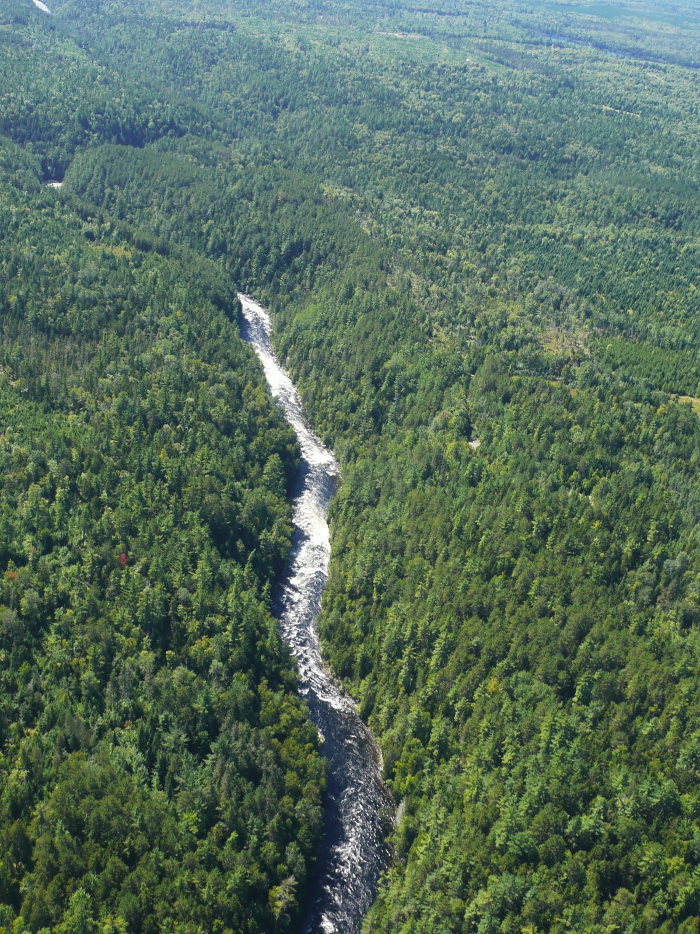

Slide 5
Battle of Long Island
After leaving Boston, General Howe decided to attack New York
A fleet of British Ships surrounded New York Bay
Howe’s British troops and the Hessians forced the Americans to retreat
Notes:
32,000 superior armed and equipped British soldiers
8,000 Hessians
Around 20,000 ragged, untrained Americans
Washington had boats brought in to get his men across the river safely
The retreat began as soon as it was dark
During the night, a heavy rain, wind and fog moved in that kept the British ships from moving and the troops from moving in
The retreat was kept such a secret, even the men didn’t know where they were going
Artillery, tents, baggage, and 9,000 men were moved across the mile-wide river in less than 13 hours
Howe was only 600 yards away and had no knowledge of the retreat
When the fog cleared, Howe attacked and found nothing when he arrived
If the British had been able to attack earlier, they could have most likely ended the war by capturing Washington and his army

Slide 6
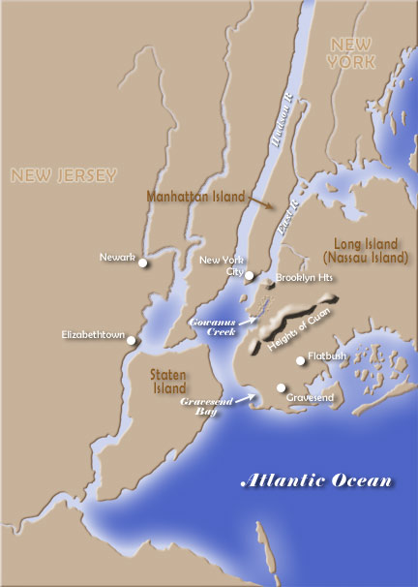

Slide 7
Trenton and Princeton
Washington surprised the Hessians at Trenton and forced them to surrender.
Washington then defeated the British at Princeton.

Slide 8
Battle of Saratoga
A major turning point in the Revolution.
The first face-to-face battle without surprises.
This battle caught the attention of France, which decided to join in the Revolution.

Slide 9
General Burgoyne had the idea to converge on Albany, New York, to control the Hudson River Valley.
They would cut off New England from the rest of the colonies.

Slide 10
Burgoyne was to meet General Howe and Colonel Leger, all coming from three different places.
Howe decided to go after Philadelphia and didn’t tell Burgoyne until it was too late.
Leger was stopped by American Militia and retreated back to Canada.

Slide 12
Burgoyne was alone and was eventually surrounded
He was forced to surrender
The Americans took 6,000 prisoners
French King Louis XVI signed the Treaty of Alliance, giving support to the Americans
(Video)

Slide 14
Valley Forge
" . . . you might have tracked the army from White Marsh to Valley Forge by the blood of their feet." - George Washington

Slide 15
Valley Forge
Valley Forge, 25 mi west of Philadelphia, was the campground of 11,000 troops of George Washington's Continental Army from Dec. 1777, to June 1778
The men were hungry, poorly clothed, and badly housed
2,500 died during the harsh winter

Slide 16
Valley Forge
"Some were still boys -- as young as 12 -- others in their 50s and 60s.
The Marquis de Lafayette wrote: "The unfortunate soldiers were in want of everything; they had neither coats nor hats, nor shirts, nor shoes. Their feet and their legs froze until they were black, and it was often necessary to amputate them."

Slide 17
Valley Forge: where a new and confident army was born
Foreign volunteers and fresh replacements slowly come in
Most important: new training transformed ragged troops into a confident military organization

Slide 18
Help From Europe
Baron Friedrich von Steuben: discharged Prussian army Captain.
Volunteered to help.
Gave men proper military training.
Used successive training.

Slide 19
New firing regulations sped up firing considerably.
Developed camp sanitation.
Laid out a plan to have rows for command, officers and enlisted men.
Kitchens and latrines on opposite sides of the camp.

Slide 20
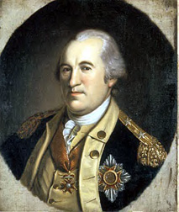

Slide 21
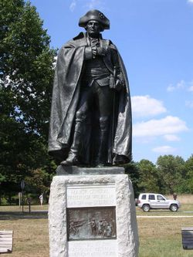

Slide 22
Marquis de Lafayette
Wealthy family
Gave $200,000 of his own money to the Americans
Became like a son to Washington

Slide 23
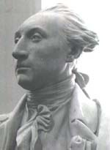

Slide 24
British Advantages
Superior naval power
Large, professional fighting force
Greater manufacturing capabilities
Wealthy country
Support from loyalists

Slide 25
British Disadvantages
Distance from England to the colonies-supplies, troops, comm.
Troops not motivated
Citizens not motivated
Hesitant to abandon traditional tactics
Not ready for conditions in America
Overconfident

Slide 26
Colonial Advantages
Fighting on familiar ground
Motivated soldiers defending the homeland
Flexibility of tactics
Colonists skilled with rifles
Leadership of George Washington

Slide 27
Colonial Disadvantages
Lack of trained fighting force
Difficulty recruiting and keeping soldiers
Presence of loyalists
Lack of supplies
Long coastline with major cities
Lack of naval power

Slide 28
The War in the West
Most Native Americans were affected by the war
Most Native Americans joined the fight against the United States
About 13,000 warriors fought on the British side

Slide 29
The War Moves South
British turned to the Southern colonies
Thought they could get more support in the south

Slide 30
African Americans in the War
Congress ordered all African Americans removed from the army
Veterans appealed to George Washington
Those already serving were allowed to stay, new enlistments were forbidden

Slide 31
many African Americans saw more opportunity on the British side
British promised immediate freedom and wages to any slave who would join

Slide 32
With the British soldiers already outnumbering the American troops, the northern colonies began to enlist African Americans

Slide 33
As the war spread into the South, Congress found it needed to recruit slaves
The slaves would receive no pay, but would be given $50 and their freedom at the end of the war if they served "well and faithfully"

Slide 34
With the offer of immediate freedom, slaves joined the British by the tens of thousands

Slide 35
Women in the War
Women ran family farms and businesses
Some were in the army camps, cooking, sewing, carrying ammunition, serving as nurses
Some worked in factories making bandages and clothing
Melted down pitchers and cups to make bullets

Slide 36
Some women took part in battles.
Molly Pitcher
Deborah Sampson

Slide 37
Victory at Yorktown
American and French effort
Led by Washington and Lafayette
British were commanded by Cornwallis

Slide 38
Cornwallis had to retreat from the south because he needed supplies and reinforcements
Retreated to the Peninsula of Yorktown
It was easier to get supplies from the British Navy at Yorktown

Slide 39
Washington heard where Cornwallis was
French Admiral was sailing his fleet of 29 ships and 3,000 men to the Chesapeake Bay
Washington knew they could trap Cornwallis at Yorktown

Slide 40
The French Fleet came in and won the battle of the bay
Cut off any chance of supplies getting through to Cornwallis
Washington and Lafayette moved their armies in
About 17,000 troops converged on Cornwallis at Yorktown

Slide 41
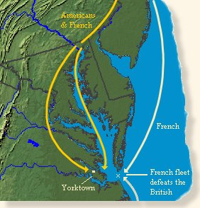

Slide 42
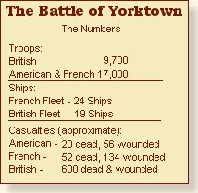

Slide 43
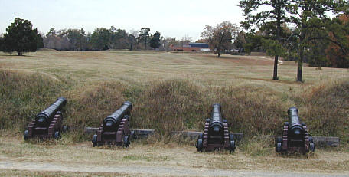

Slide 44
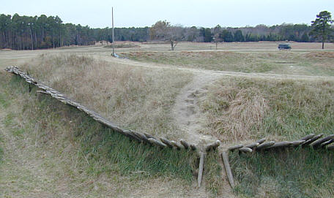

Slide 45
Cornwallis soon surrendered
7,000 British troops became prisoners
A formal surrender ceremony took place the next morning
Cornwallis refused to attend out of humiliation, but claimed illness

Slide 46
Treaty of Paris of 1783
The Treaty of Paris of 1783 officially ended the Revolutionary War
The Treaty included Great Britain, United States, France and Spain

Slide 47
The treaty contained certain terms:
recognizing the thirteen colonies as free states
Establishing boundaries between the United States and British North America

