Slide 1
The Hunger Games: Catching Fire
Mr. W. Alvarez

Slide 2
The Quarter Quell
Every twenty-five years there is a Quarter Quell edition of theHunger Games. Quarter Quells mark the anniversary of thedistricts' defeat by the Capitol, and include special celebrations. The Games involves some sort of twist that makes them more disastrous or difficult to compete in, or watch. A small box contains small yellow envelopes containing specific instructions for each Quarter Quell. These instructions were planned at the founding of the Hunger Games, with plans in place for hundreds of Games. The President at the time selects the appropriate card and reads it on live television to announce the theme of that year's Quell. It is unknown how many Quarter Quells were planned ahead of time, but some suspect that the 75th had been changed so that Katniss Everdeen, the female tribute from District 12 who won the previous year, would be forced to go back into the arena once more.

Slide 3
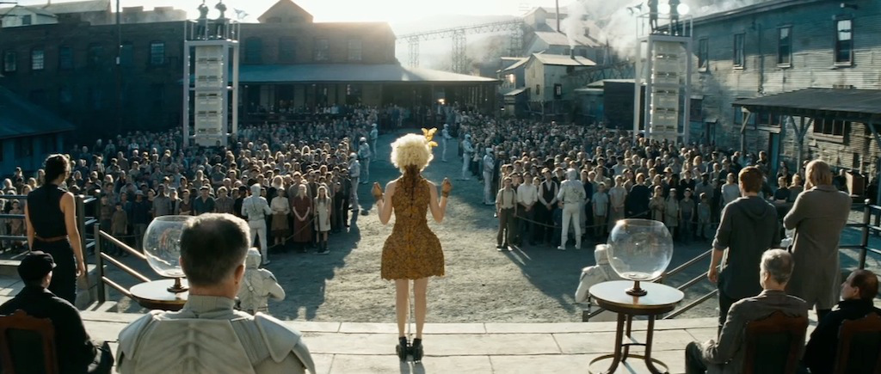
District 12’s Quarter Quell reaping

Slide 4
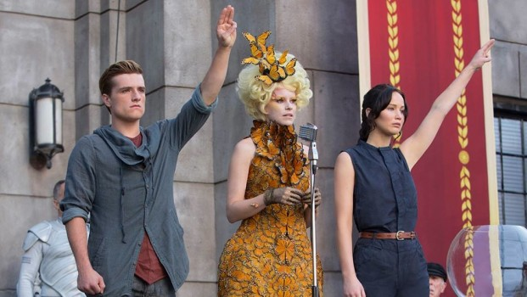

Slide 5
Characters from

Slide 6
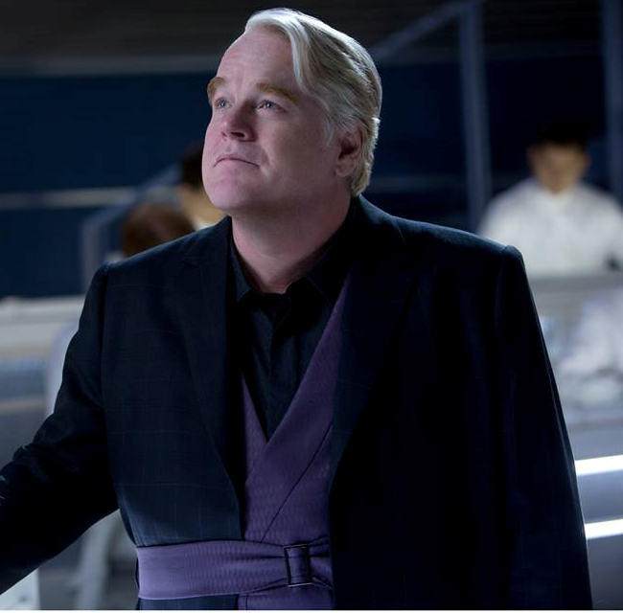
Plutarch Heavensbee
Plutarch is first seen in The Hunger Games, as an anonymous character. He does NOT appear in the movie. Katniss Everdeen is in her private session with the Gamemakers, and angry at being ignored when her life is in turmoil. When she shot her arrow at the apple in the roasted pig's mouth, Plutarch fell backwards into a punch bowl, knocking it to the floor. During the interview, when Caesar Flickerman asks Katniss for details about her private training session, he jumps in saying that she can't reveal any details. After the end of the Games, Seneca Crane is executed, and Plutarch is appointed to be the new Head Gamemaker, citing that there were not many takers for the job.

Slide 7
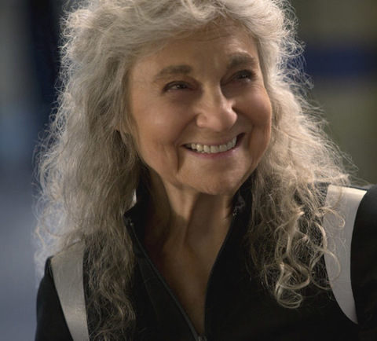
Mags
The female tribute from District 4. She is around 80 years old and volunteered to take the place of a young woman, Annie Cresta, to spare her. Mags is one of the first people Katniss wants for an ally, along with Beetee and Wiress. Katniss observed that she can make a fishing hook out of anything. Unfortunately, while the group are trying to escape poison fog, Mags gives herself up without a question so Finnick could carry a wounded Peeta to safety.

Slide 8
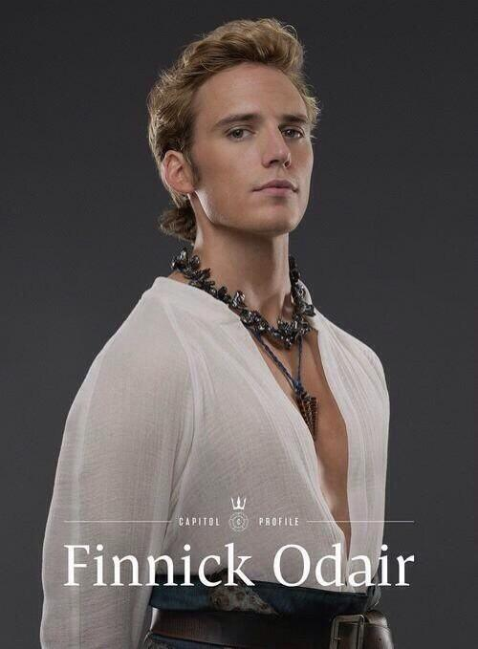
Finnick Odair
The male tribute from District 4. He won the 65th Hunger Games by using a net he wove himself and a trident he received as a gift from sponsors; District 4's trade is fishing. Finnick is described as being one of the most stunning, sensuous people on the planet. He is known for his attractive sea green eyes and bronze hair. During the Quarter Quell, a jabberjay recording of his one true love, Annie Cresta, screaming is used as psychological torture. Katniss was hesitant to make Finnick her ally, but he proved to be valuable when he helped Peeta off his plate and then administered CPR after he hit the force field. Finnick was a key person in the rebellion, as revealed to Katniss in the hovercraft at the end of the book.

Slide 9
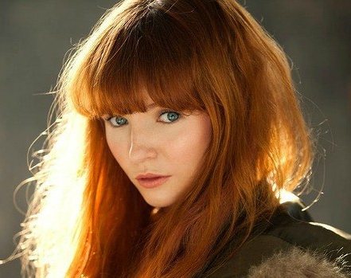
Annie Cresta
In Catching Fire, Annie was reaped to participate in the 75th Hunger Games, but Mags, an older tribute, who mentored Finnick and Annie during their Hunger Games, volunteered to enter the Games in her place. After the jabberjay attack in the arena, Finnick tells Katniss about Annie.

Slide 10
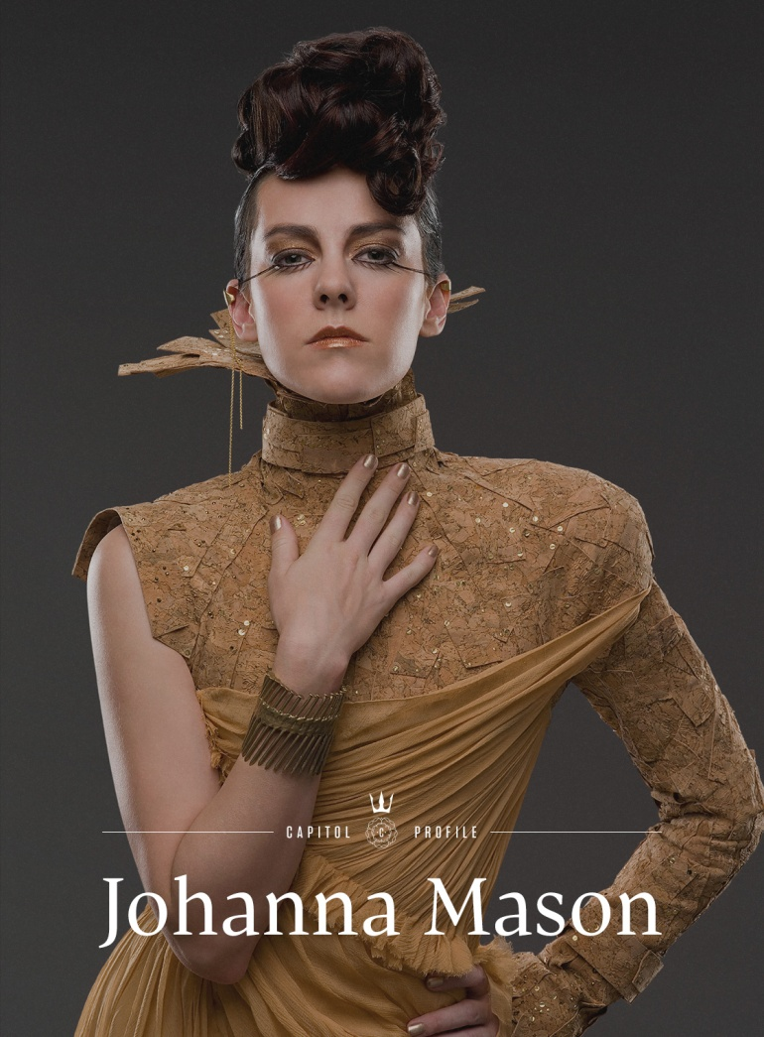
Johanna Mason
The female tribute from District 7. She won an earlier Hunger Games by pretending she was a weakling until there were only a handful of tributes left, then showing that she could kill viciously. Katniss remembers watching these Games herself, so Johanna is fairly young. Johanna was captured by the Capitol at the end, along with Peeta and Enobaria.

Slide 11
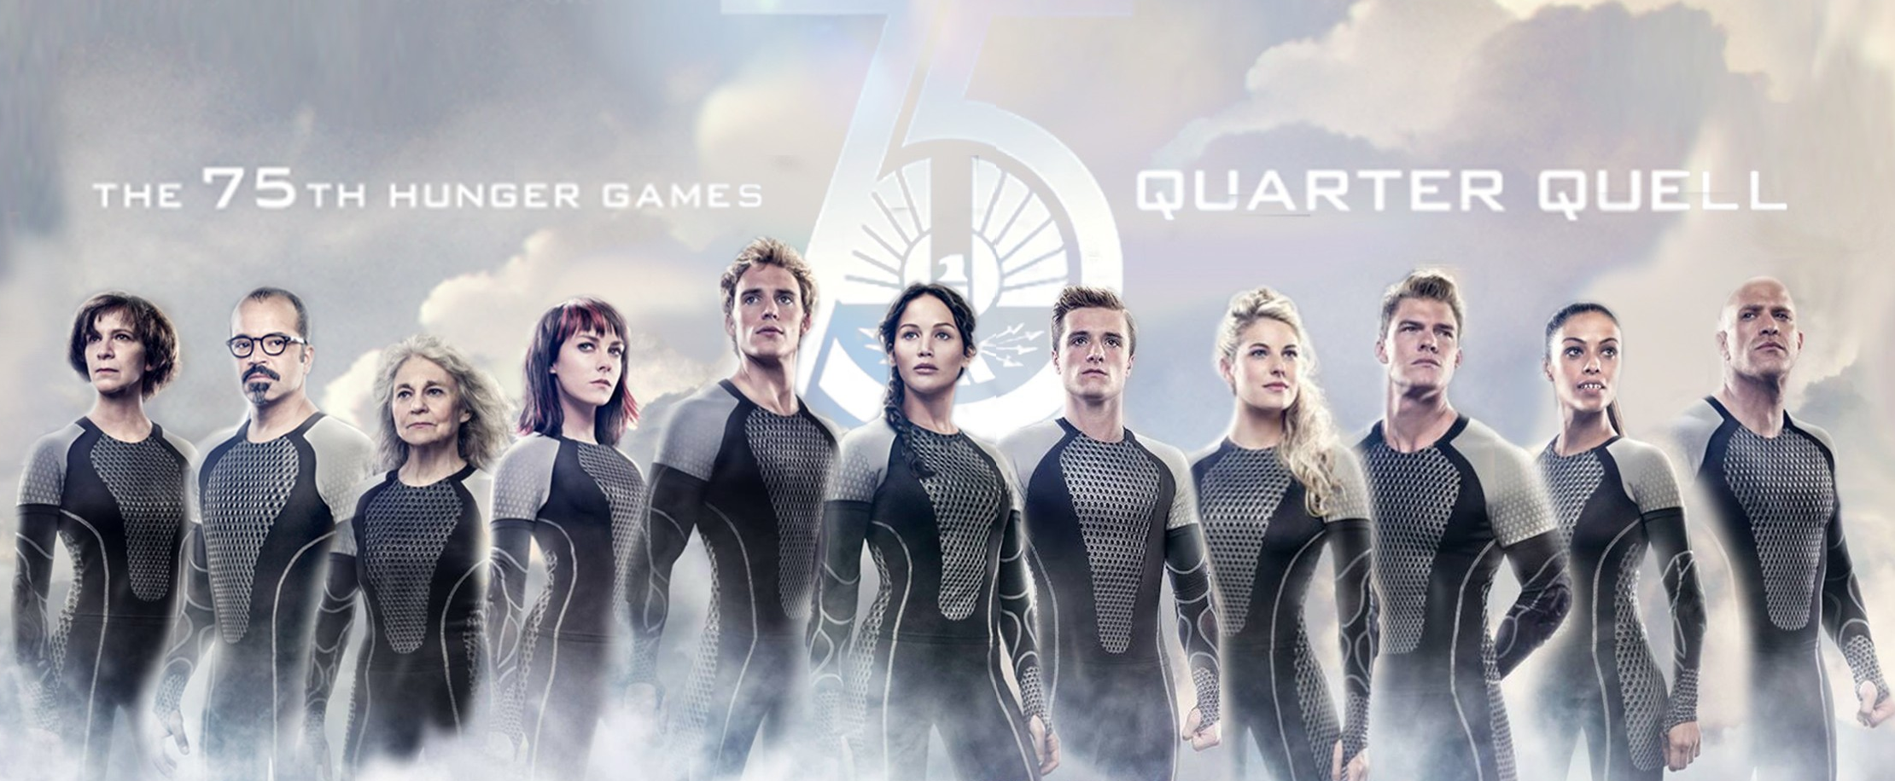
Other tributes

Slide 12
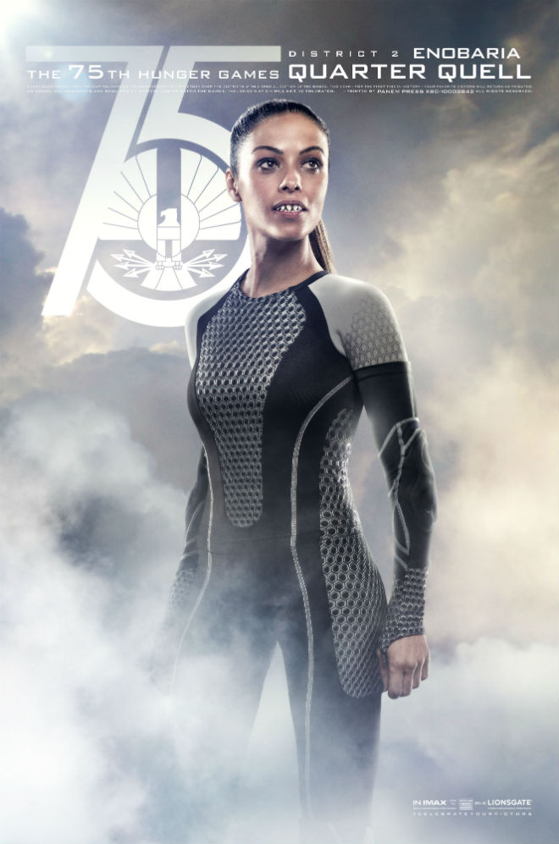
Enobaria
The female tribute from District 2. She is famous for ripping a tribute's throat out with her teeth during Games that she won. After she won her first Games, she altered her teeth to be razor-sharp and plated them with gold. She is a threat in the arena and is later captured by the Capitol along with Peeta and Johanna.

Slide 13
Brutus
Brutus was named seemingly perfectly as it mirrors his brutality, animal-like nature and strength. He is believed to be very skilled, as Haymitch was surprised that even he wanted to team up with Katniss after seeing her skills with a bow. Also Brutus probably won the 46th-53rd Hunger Games due to his age. He was a Career tribute, part of the main pack, and won his Games fairly close to the time fellow District 2 Tribute, Lyme, won hers. Both Lyme and Brutus became mentors for later tributes, possibly including Enobaria.

Slide 14
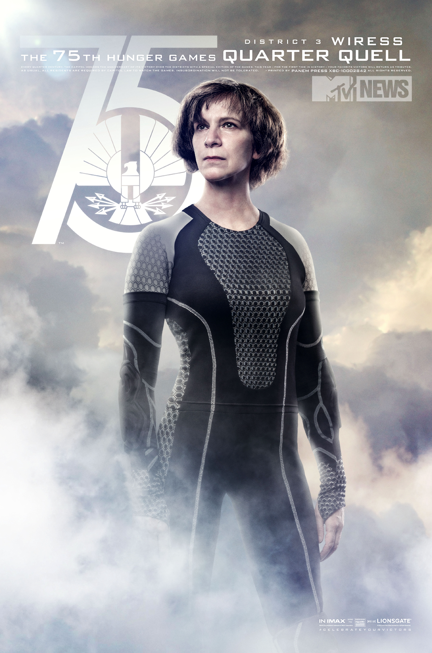
Wiress
The female tribute from District 3. Wiress often doesn't finish her sentences; Beetee often finishes them for her. Though very smart and able to figure out that the Quarter Quell arena acted like a clock, Wiress is killed by the male tribute from District 1, Gloss, when he slits her throat.

Slide 15
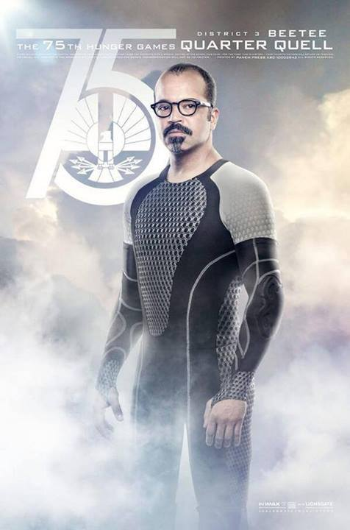
Beetee
The male tribute from District 3. He is very skilled with a wire, which planned to use to blow up the arena's forcefield, but Katniss shoots an arrow into it instead, and joins Katniss at the end on the way to District 13.

Slide 16
Cashmere and Gloss
Brother and sister, from District 1.
Cashmere A victor of an unspecified Hunger Games, Cashmere was reaped along with her brother Gloss for the third Quarter Quell. She and Gloss both won the Hunger Games in consecutive years when Katniss was younger. As a Career Tribute, Cashmere was arrogant and conceited, even though she didn't become friends or allies with Katniss, she and her brother still managed to become friends with the other tributes.
Gloss was the male District 1 tribute in the 75th Hunger Games. He was known for winning an unspecified Hunger Games consecutively with his sister Cashmere. Gloss won a previous Hunger Games when Katniss was a child. After his games, his sister Cashmere won her games. It is mentioned that the Capitol has been obsessed with him and his sister since their consecutive victories.

